Slide 1
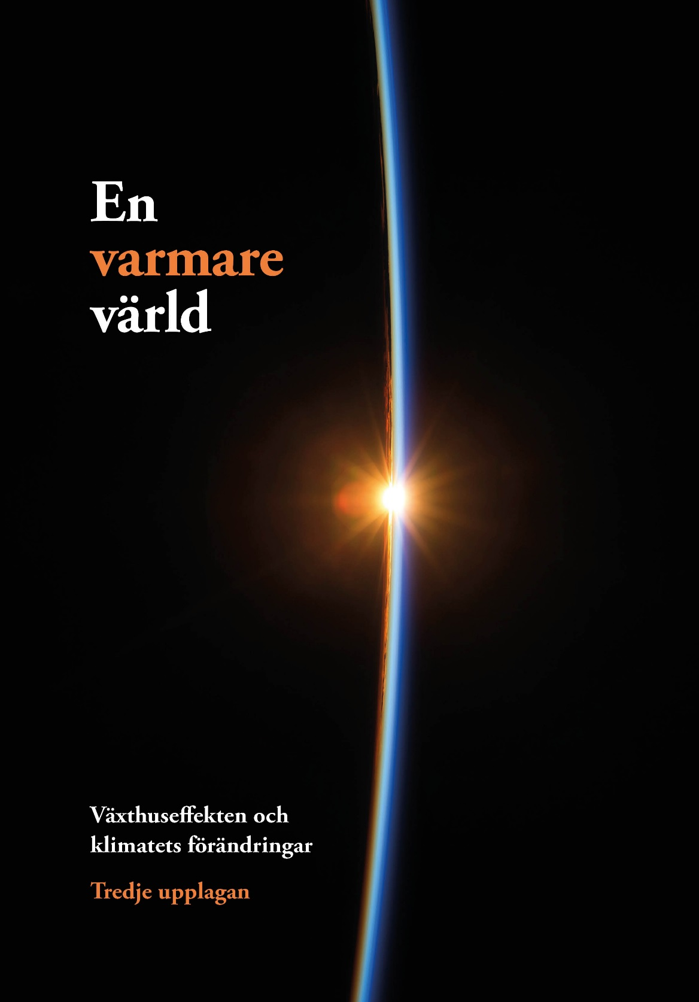
Notes:
A warmer world
We live in a world that is getting warmer. This presentation presents a brief summary of the climate issue. It is based on the Swedish Environmental Protection Agency’s book about climate change, En varmare värld (A Warmer World), which was last published in 2016. The presentation was updated in 2024 with the latest data.

Slide 2
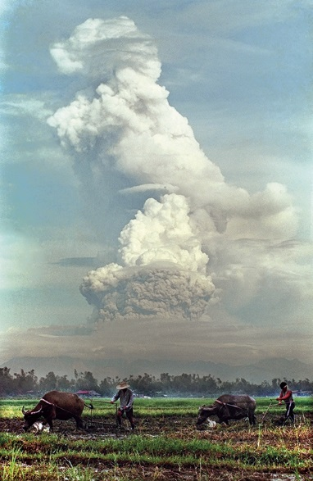
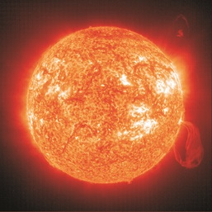
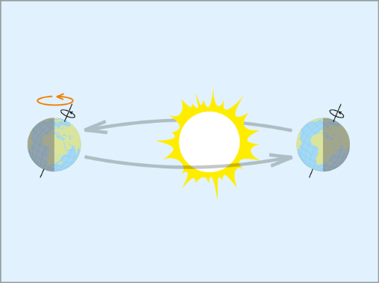
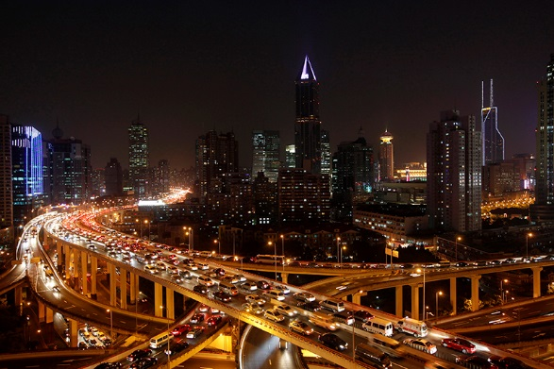
What can change the climate?
^{SOHO, EIT (ESA & NASA)}
^{BULLIT MARQUEZ, TT NYHETSBYRÅN}
^{ALY SONG, TT NYHETSBYRÅN}
Notes:
What can change the climate?
The Earth’s climate can be affected by many natural causes:
Large volcanic eruptions can fill the upper atmosphere with particles that temporarily block some of the sunlight. (The leftmost image shows the eruption of the Pinatubo volcano in the Philippines in 1991.)
The sun’s own brightness varies slightly from year to year.
Slow changes in the Earth’s orbit around the sun and in the direction of the Earth’s axis are responsible for the shifts between ice age conditions and the kind of milder climate we experience today. (The top-right image shows how the Earth’s axis changes direction.)
But humans have also started to have an impact on the climate:
Some of our pollution emissions fill the air with particles that block or trap sunlight.
Other emissions amplify the atmosphere’s greenhouse effect. (The bottom-right image shows present-day Shanghai.)

Slide 3
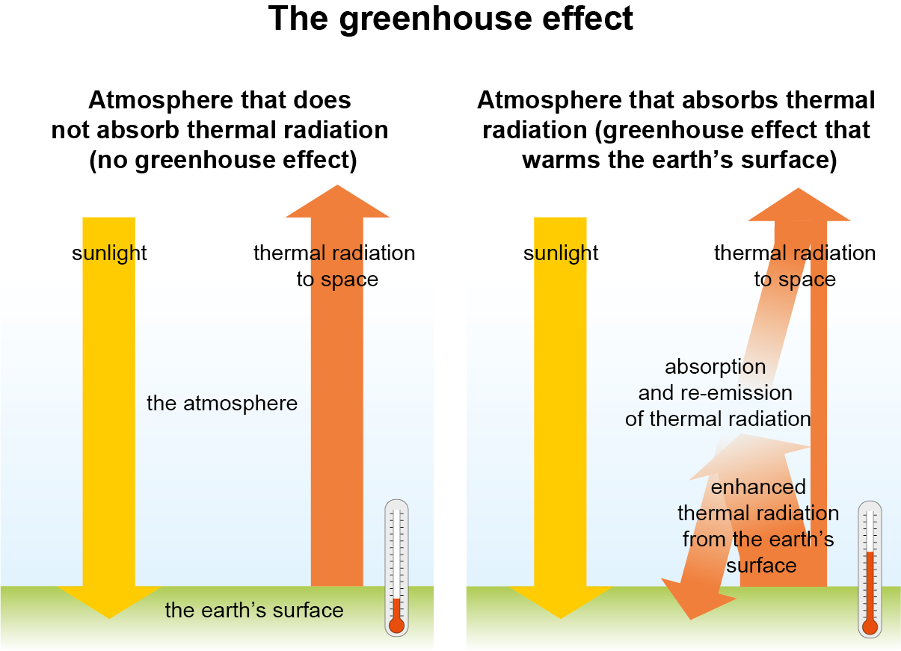
The greenhouse effect
Notes:
The greenhouse effect
Sunlight reaching the Earth’s surface is converted into heat (left image). The energy is then emitted back into space as thermal radiation. Without the atmosphere's ability to trap this radiation, Earth’s surface would be extremely cold.
In reality, the atmosphere contains gases that can block thermal radiation (right image). Some of the trapped heat is sent back towards the Earth’s surface, making it warmer than it would otherwise be. This is what we call the greenhouse effect.

Slide 4
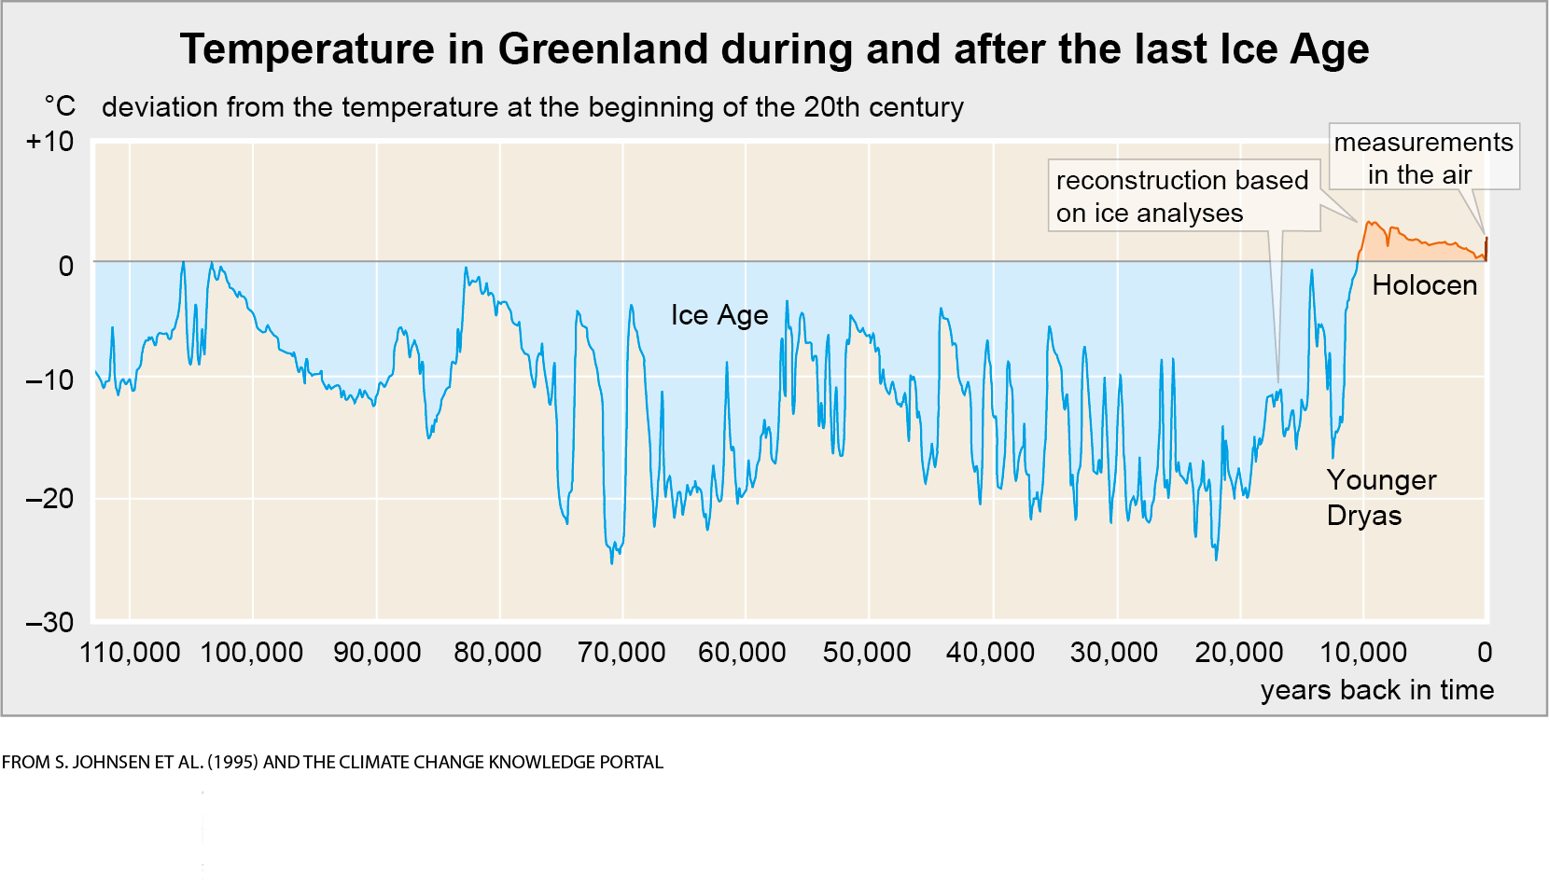
Climate change in the past
Notes:
Climate change in the past
The Earth’s climate has undergone major changes over the course of millennia and millions of years. During the last Ice Age, the climate was very unstable, especially in our part of the world. Temperatures could change drastically in just a few decades, mainly due to variations in the characteristics of ocean currents.
When the Ice Age ended more than 10,000 years ago, the climate not only became warmer but also much more stable. This allowed people to take up farming, laying the foundation for the rapid advancement of culture, society and technology in the centuries that followed.
The graph shows temperature data from Greenland. In other parts of the world, climate change varies somewhat differently. For example, on average for all of Earth, it is probably warmer today than it ever was during the Holocene. The instability during the Ice Age and the stability during the Holocene (until the 20th century) have been repeated everywhere.

Slide 5
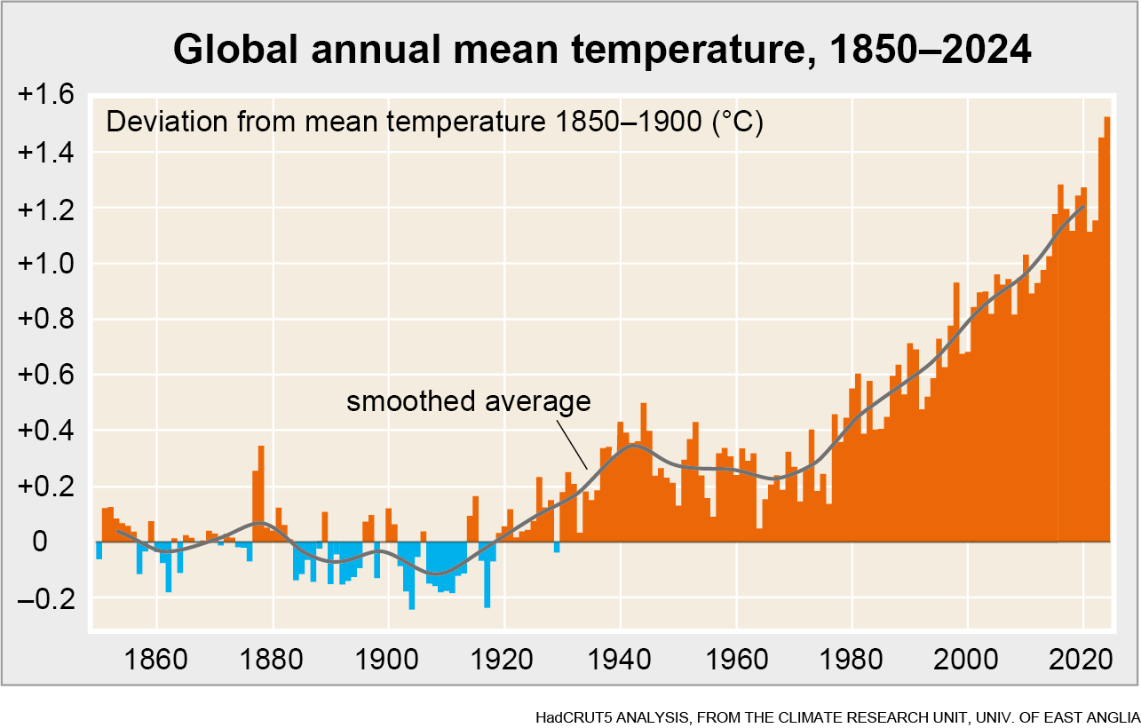
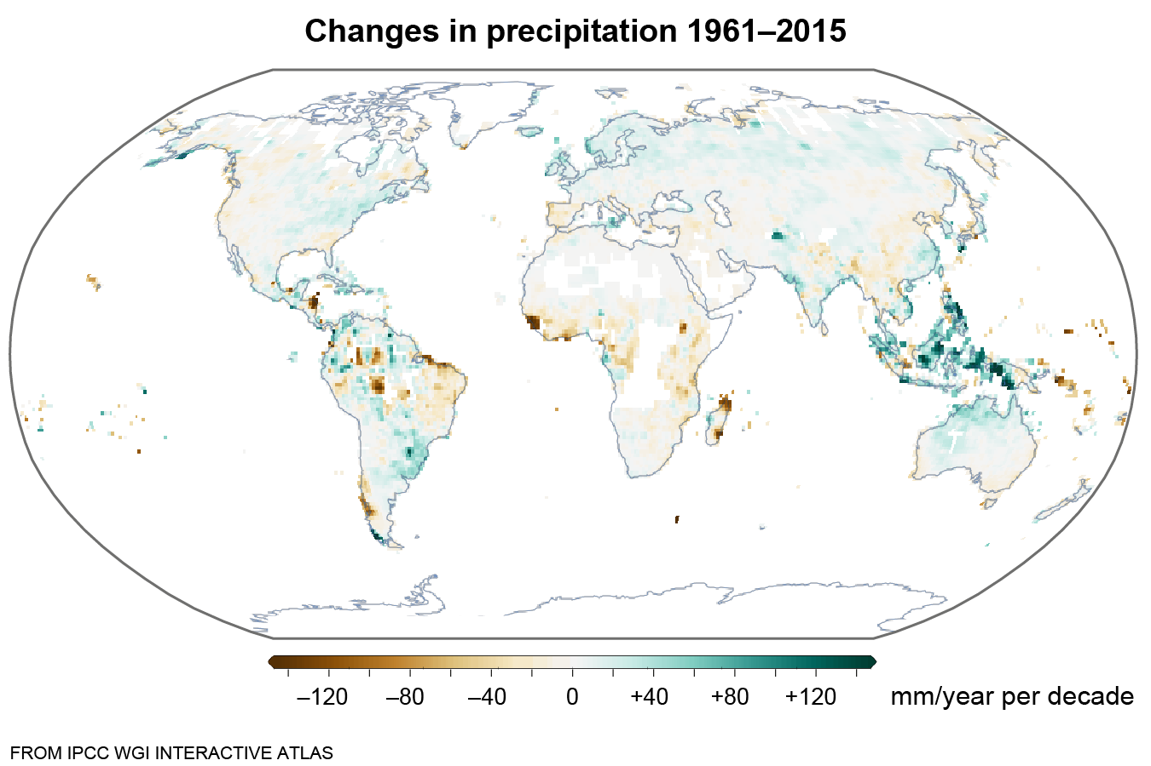
Climate change in modern times
Notes:
Climate change in modern times
Since the early 20th century, temperatures have increasingly deviated from the fairly stable levels of previous centuries (top image). Warming has been especially pronounced since the 1970s, with the decade 2014–2024 averaging about 1.2 degrees warmer than the second half of the 19th century.
Precipitation has increased in some areas but decreased in others (bottom image). The reductions have mainly taken place in areas that were already dry.

Slide 6
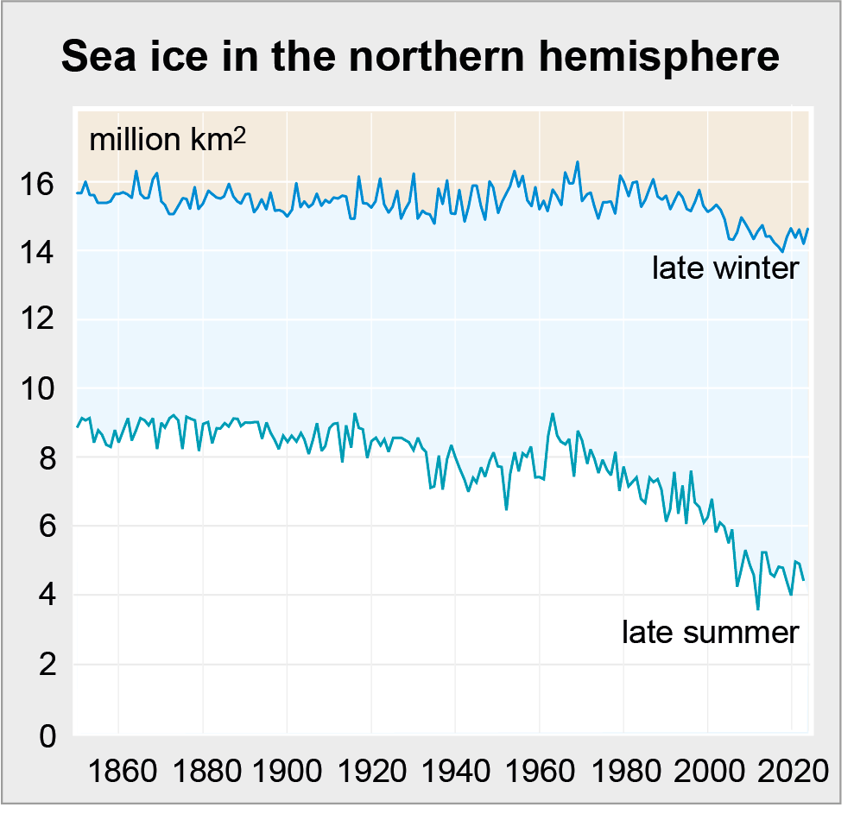
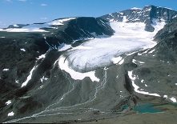
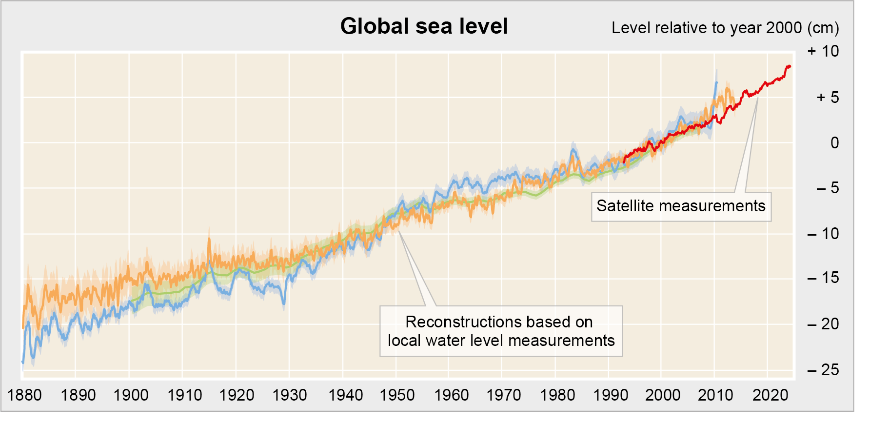
The consequences of global warming
PER HOLMLUND
^{FROM WALSH ET AL. (2016)} ^{AND OUR WORLD IN DATA}
FROM RAY & DOUGLAS (2011), CHURCH & WHITE (2011), JEVREJEVA ET AL. (2014) AND NASA
Notes:
The consequences of global warming
Over the past century, rising temperatures have led to a continued decline in ice and snow cover. In particular, Arctic sea ice has shrunk significantly, especially in summer (left image).
Another consequence of global warming is that the world’s sea level has slowly but surely started to rise (bottom image). Since the early 20th century, the level has risen by nearly 25 cm. The rise is partly caused by glacier melting (see the photo showing Storglaciären at Kebnekaise). Another reason is that sea water expands as it warms.

Slide 7
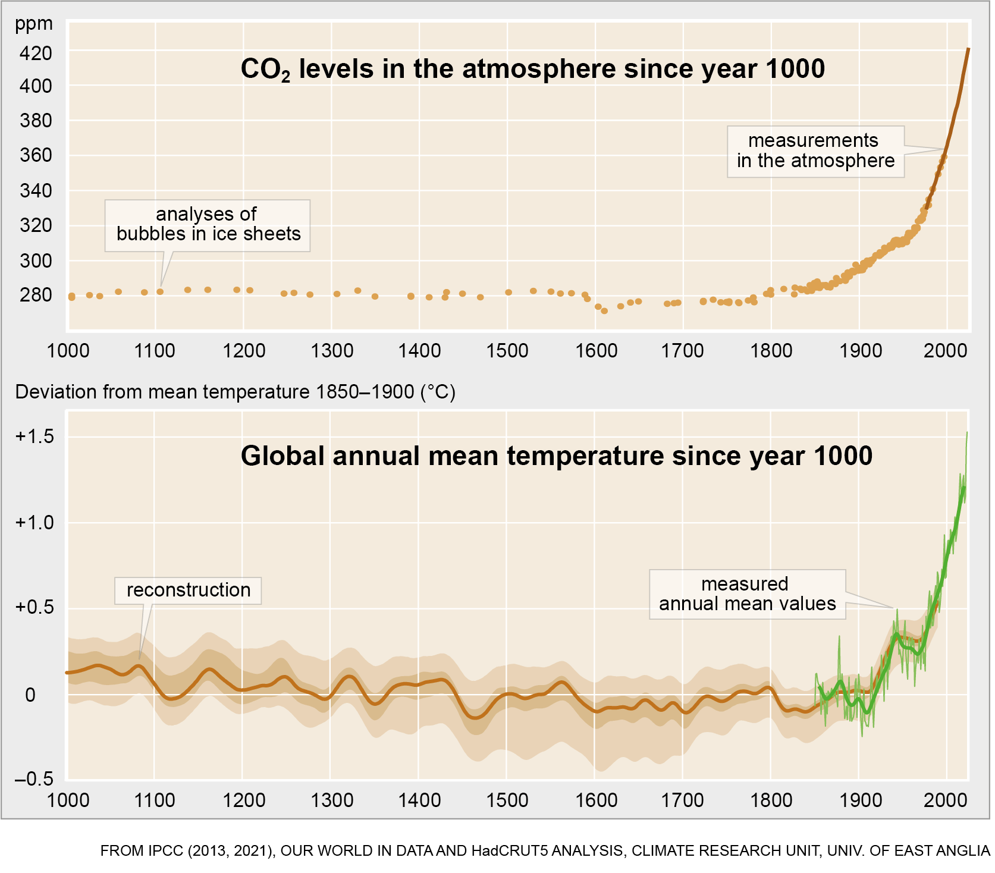
Why is the climate changing now?
Notes:
Why is the climate changing now?
The rise in temperature since the 19th century is consistent with the increase in carbon dioxide and other greenhouse gases in the air over the same period. The rapid warming since the 1970s can only be explained as the result of an amplified greenhouse effect.

Slide 8
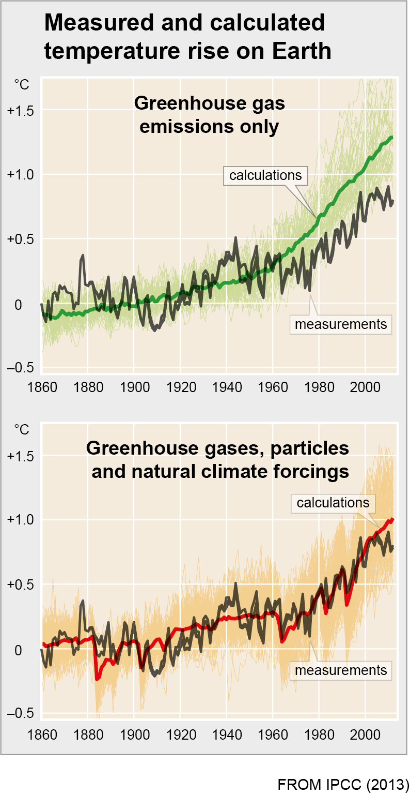
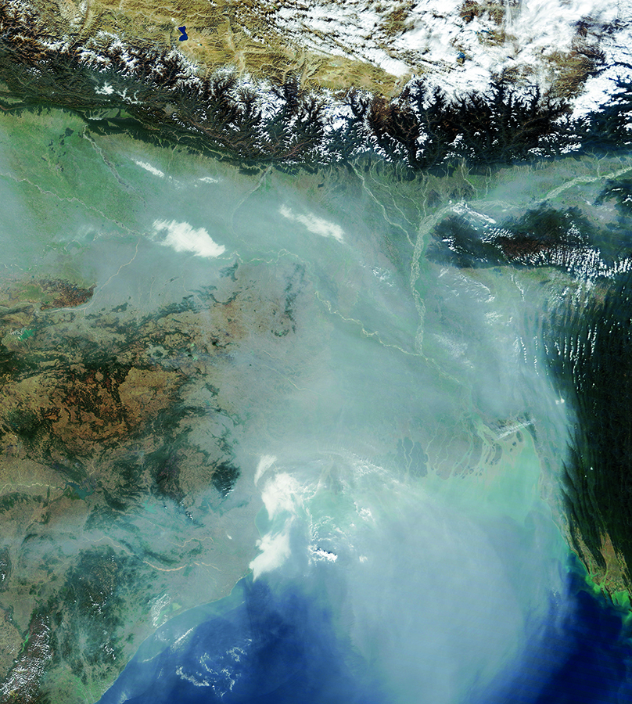
Why hasn’t it become even warmer?
^{NASA EARTH OBSERVATORY}
^{FROM IPCC (2013)}
Notes:
Why hasn’t it become even warmer?
Researchers calculate that if climate change had been caused solely by greenhouse gas emissions, the warming would have been slightly greater than what was actually measured (top graph).
If these calculations also take into account particle emissions and natural climate forcings (volcanic eruptions and changes in solar radiation), the results are more consistent with the measured temperature increase (bottom graph). Both particulate matter emissions and natural climate forcings have counteracted warming in recent decades. If particulate matter emissions are reduced in the future, the greenhouse effect will become more pronounced.
Particulate air pollutants are emitted from industry, power plants and traffic, as well as from small-scale combustion for heating, cooking, etc. (The satellite image shows particle veils over Bangladesh and eastern India.)

Slide 9
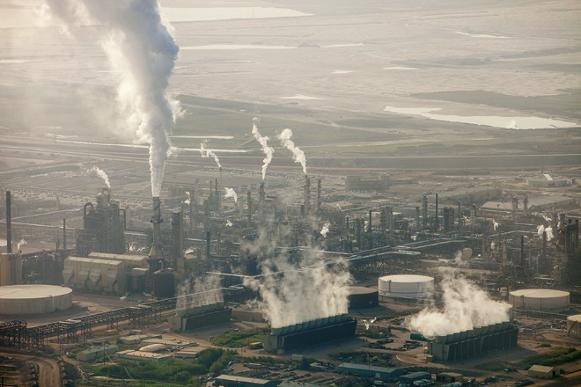
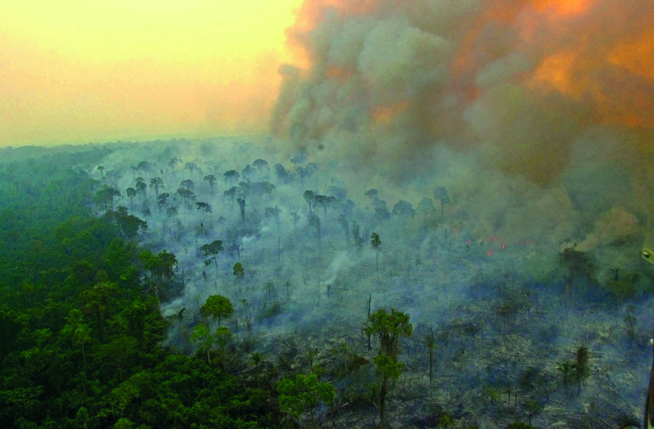
Where do carbon dioxide emissions come from?
^{ASHLEY COOPER, IBL}
^{DADO GALDIERI, TT NYHETSBYRÅN}
Notes:
Where do carbon dioxide emissions come from?
The rise in carbon dioxide levels in the atmosphere, and the resulting increase in the greenhouse effect, is mainly due to our use of coal, oil, fossil gas (natural gas) and similar fossil fuels. These fuels are composed of carbon compounds and are the remains of plants or animals that lived many millions of years ago. When we burn these fuels, their carbon content combines with oxygen and enters the air as carbon dioxide. (The photo on the left shows the extraction of oil from oil sands in Canada.)
Wood and other biofuels are also composed of carbon compounds. Therefore, carbon dioxide is also produced when we use such fuels, but unlike fossil fuels, biofuels are part of a continuous cycle. When we burn wood, the carbon dioxide released is the same that the trees recently absorbed from the atmosphere. If new trees are allowed to grow, this carbon dioxide will soon be reabsorbed and stored in the wood again. As a result, the use of biofuels generally does not contribute to the long-term amplification of the greenhouse effect.
However, if we burn down forests or burn wood without replacing the trees with new forests, the carbon dioxide released remains in the atmosphere. Deforestation therefore contributes to an increase in atmospheric CO₂ levels and an increase in the greenhouse effect. (The photo on the right shows forests in Brazil being burned to convert to farmland.)

Slide 10
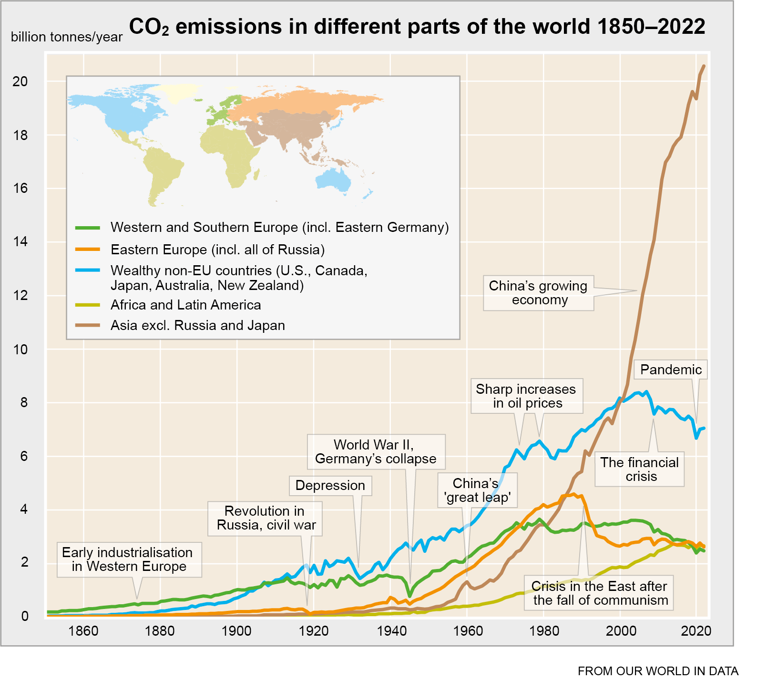
How have carbon dioxide emissions changed?
^{FROM OUR WORLD IN DATA}
Notes:
How have carbon dioxide emissions changed?
The use of fossil fuels has so far been strongly linked to economic development, with carbon emissions rising during periods of economic growth and falling during economic crises and downturns. In wealthier countries, emissions began to grow significantly in the early 20th century and continued to rise sharply until the oil crises of the 1970s. In recent decades, however, the largest increases in emissions have occurred in countries outside the early industrialised world.

Slide 11
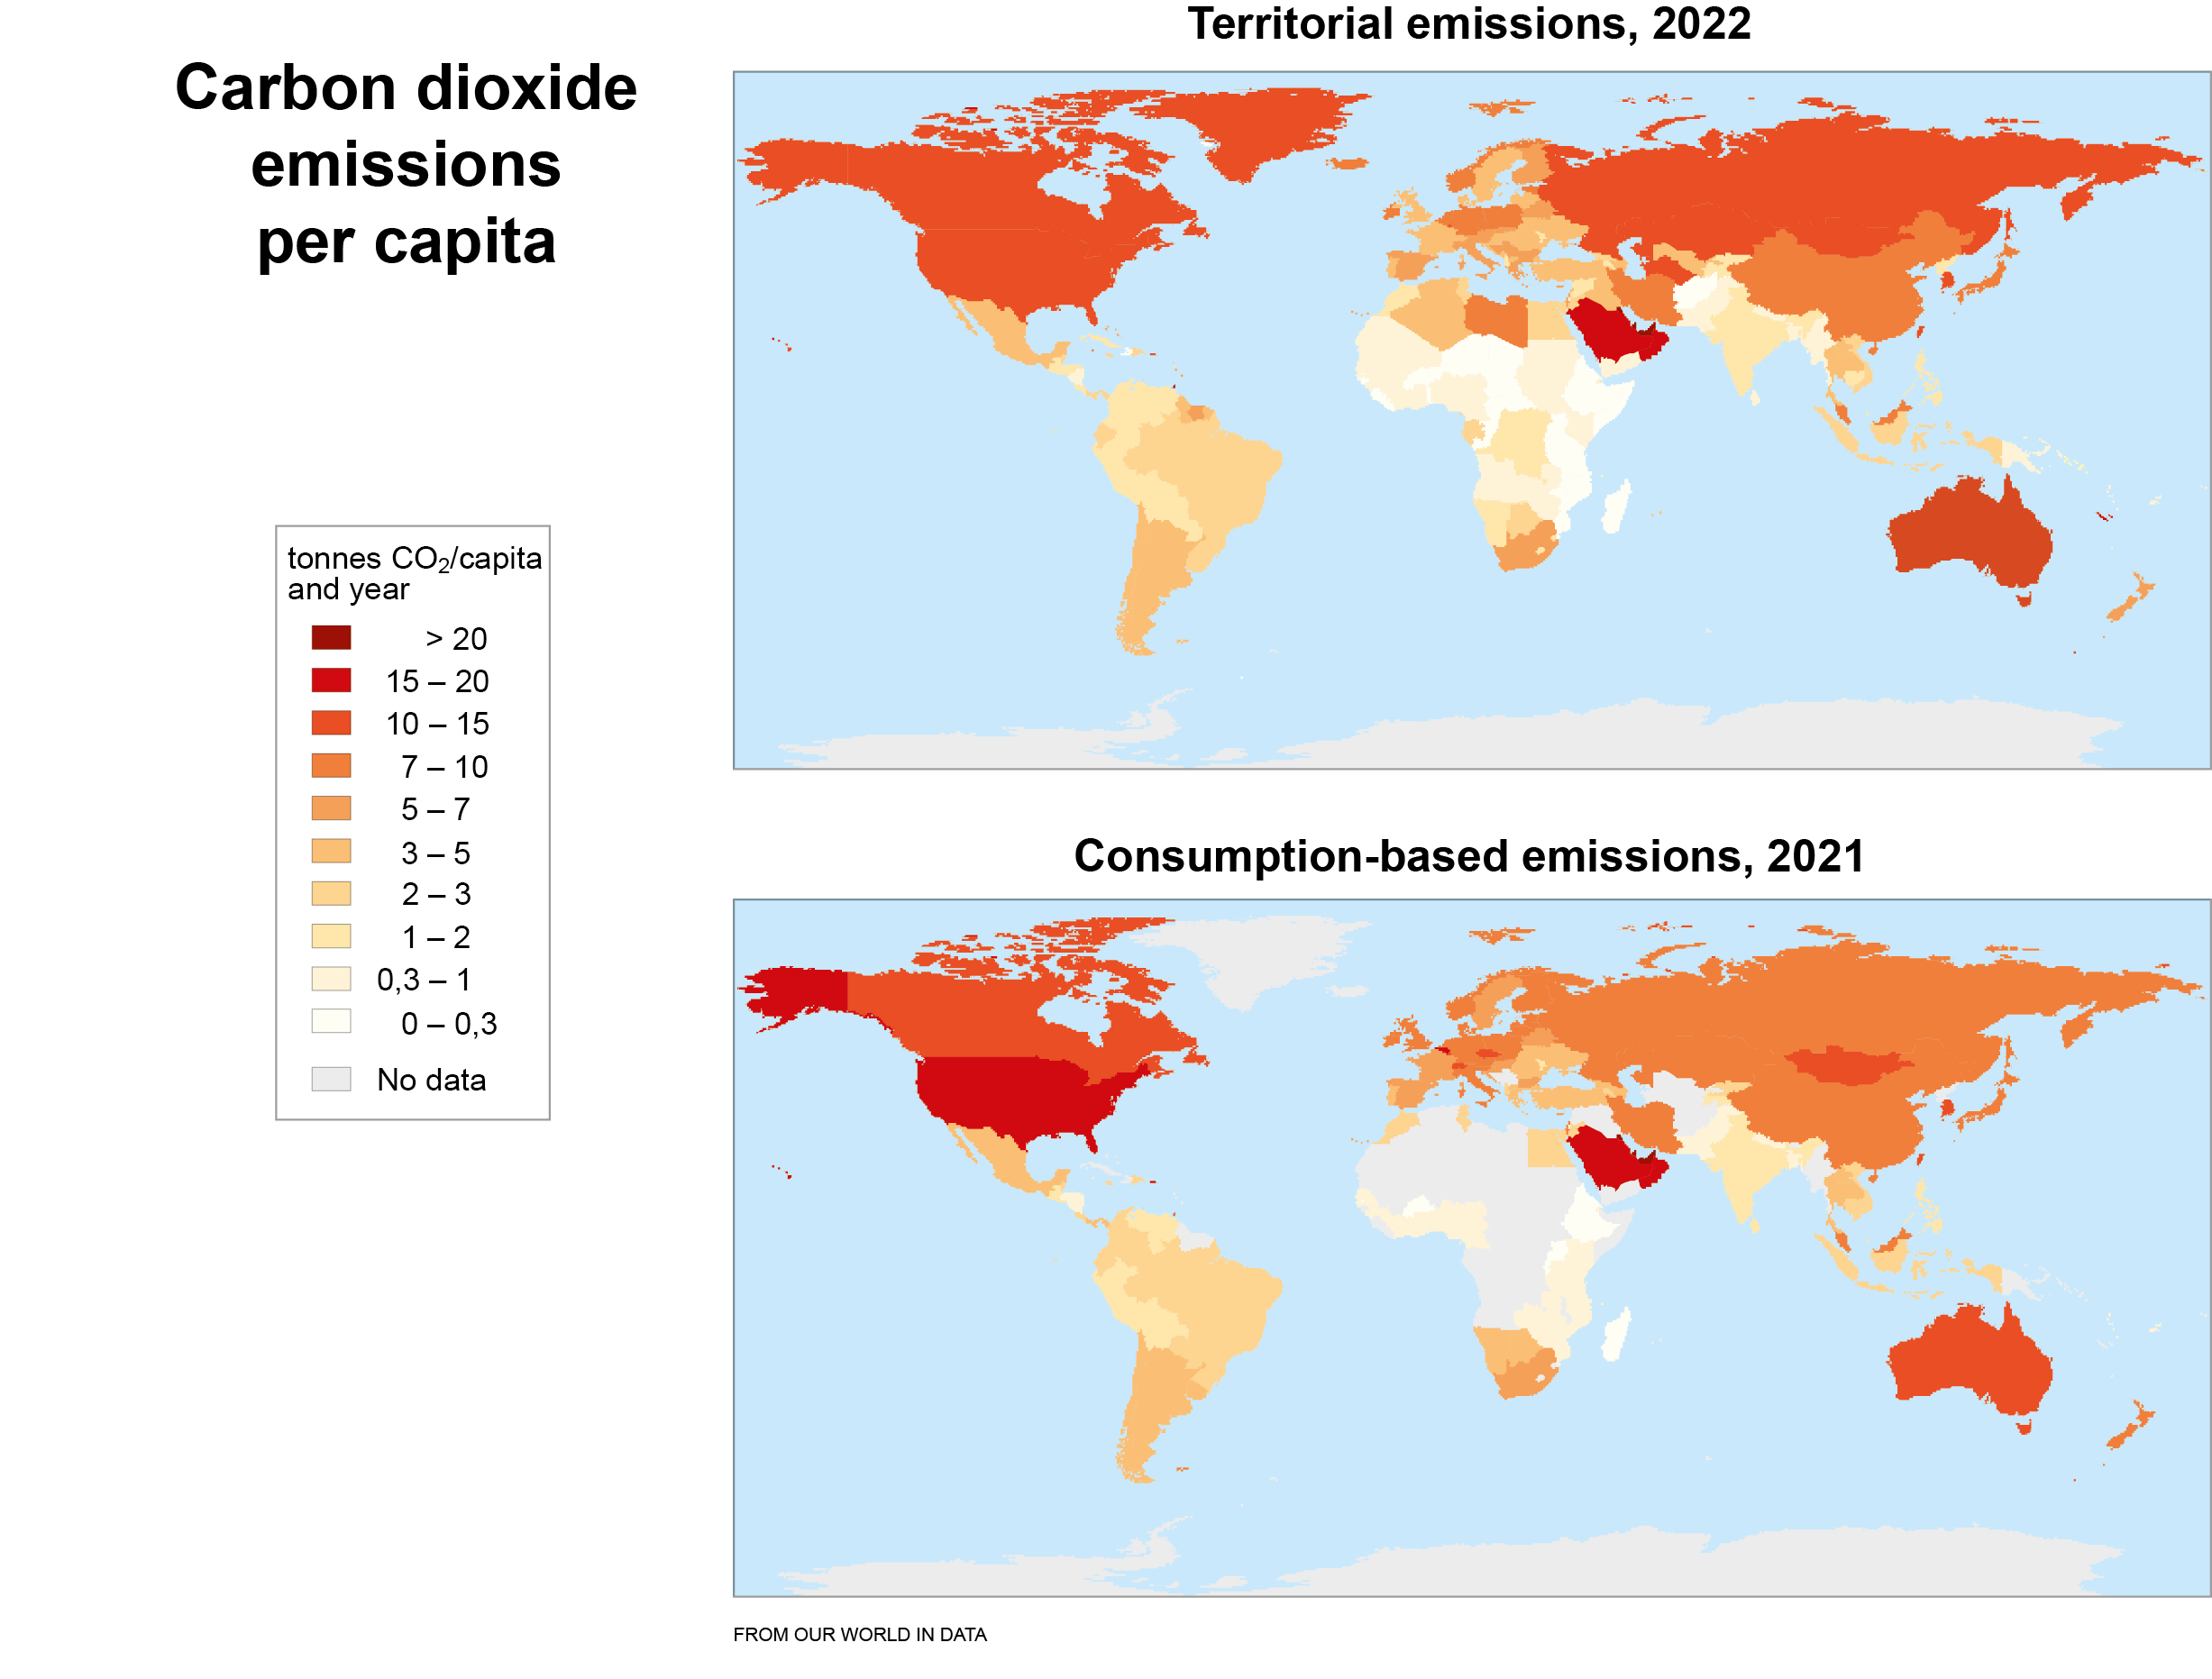
Notes:
Carbon dioxide emissions per capita
Despite recent increases in emissions in countries outside the early industrialised world, CO₂ emissions per capita remain significantly lower in most cases compared to wealthier countries. In the world’s poorest regions, per capita emissions are often just a fraction of those emitted in the U.S. and Canada, for example.
The upper map shows territorial emissions (emissions within each country’s borders), while the lower map shows consumption-based emissions (where emissions from goods and services are allocated to the country where they are consumed rather than produced).

Slide 12
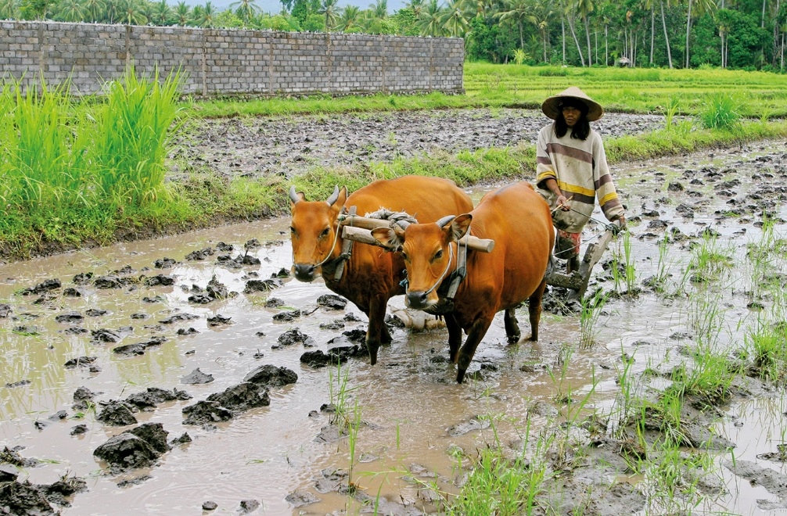
Other greenhouse gas emissions
^{ANDRÉ MASLENNIKOV, AZOTE}
Notes:
Other greenhouse gas emissions
Along with emissions of carbon dioxide, emissions of other greenhouse gases also intensify the greenhouse effect and contribute to climate warming. Methane is released from waste dumps, rice fields and ruminant livestock (as in this photo of a rice farm in Indonesia), while nitrous oxide is mainly released from cropland fertilised with nitrogen.
Today, the atmosphere also contains chlorofluorocarbons (CFCs, or ‘freons’) and other human-made compounds containing chlorine, bromine or fluorine, which have been released into the air in one way or another. Though present in low concentrations, these substances have a potent greenhouse effect and are very long-lived in the atmosphere. While CFC production has significantly decreased, the production of related compounds must also be reduced.

Slide 13
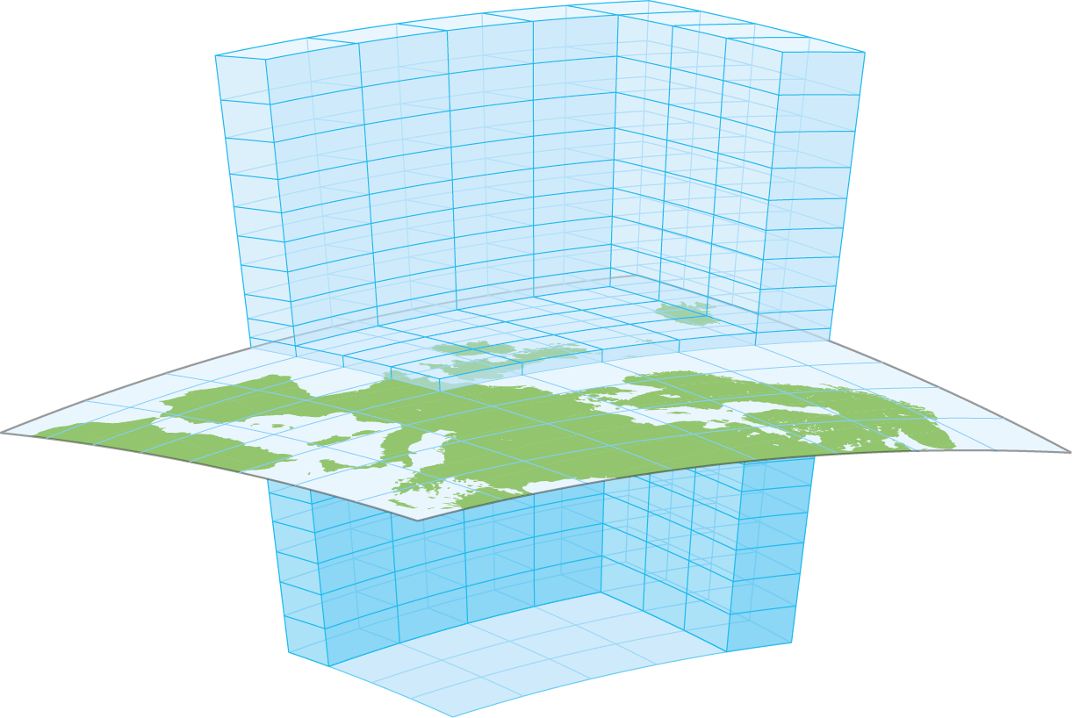
Climate models
Notes:
Climate models
To predict how current and future greenhouse gas emissions will affect the Earth’s climate, scientists use climate models. These models are computer programmes that calculate how temperature and other properties of air, soil and water change over time. A climate model divides the atmosphere, the Earth’s surface and the ocean into a large number of ‘cells’. The image shows a small part of these cells in a climate model covering the entire Earth. Regular weather forecasts are based on similar models and calculations.

Slide 14
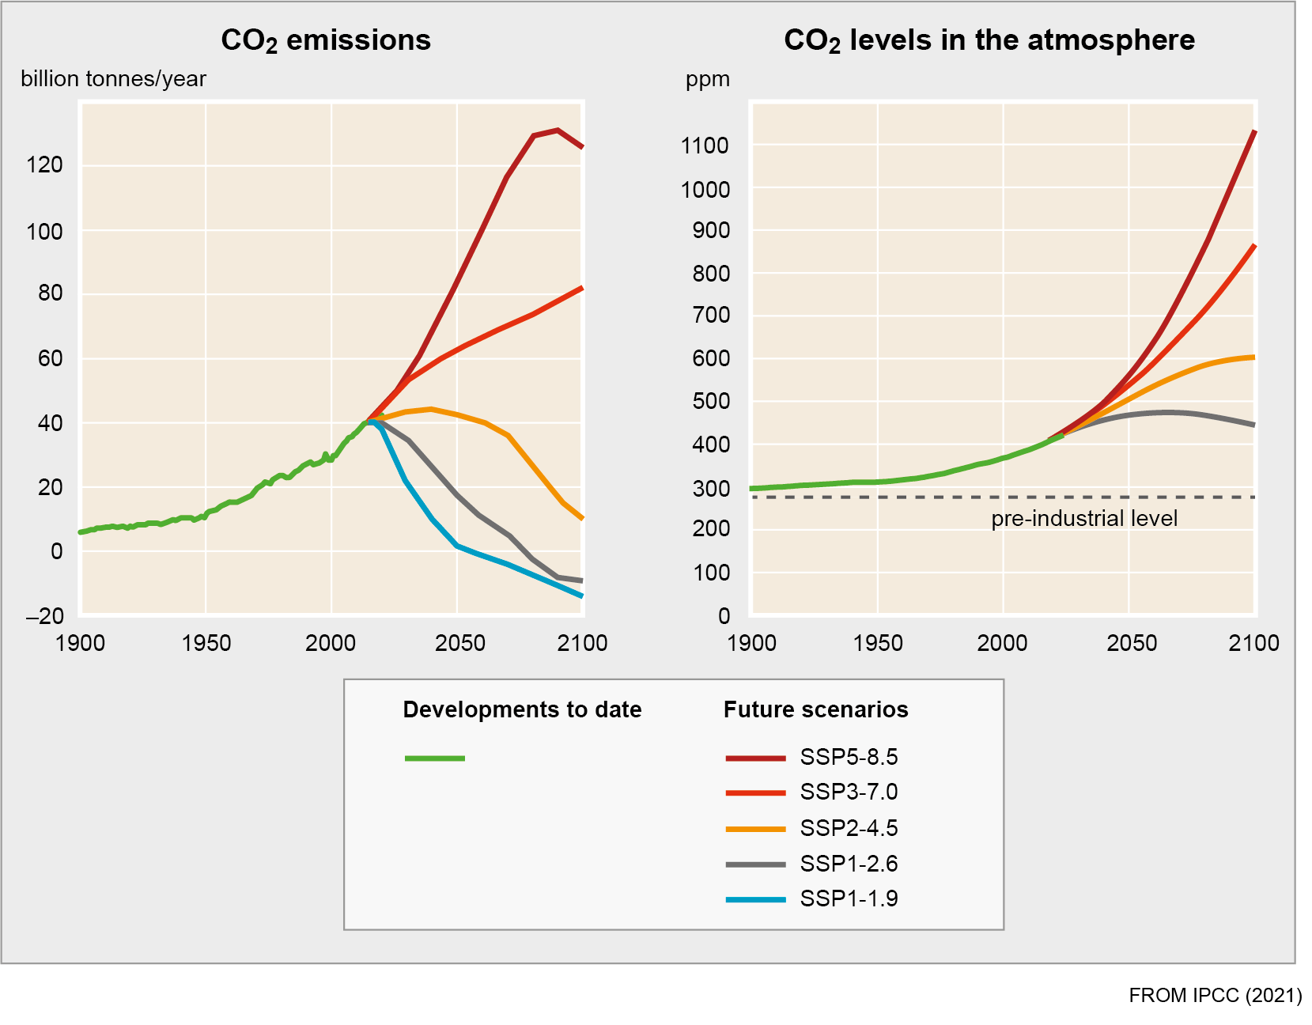
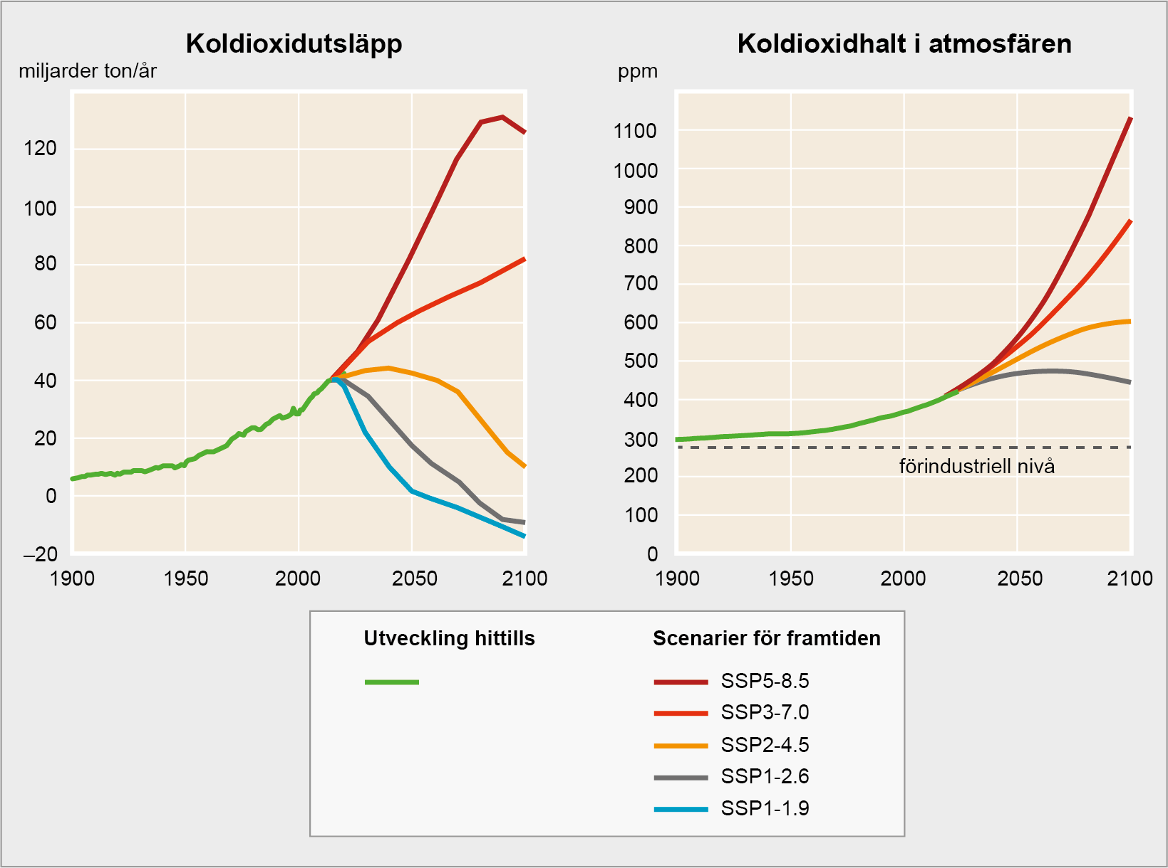
Scenarios for CO₂ emissions and levels
^{FROM IPCC (2021)}
Notes:
Scenarios for CO₂ emissions and levels
No one can know for sure today how human emissions of carbon dioxide and other greenhouse gases will evolve in the future. So, scientists use various scenarios to project future climate change. Current climate change projections for the remainder of this century are often based on five so-called SSP scenarios. In one of these scenarios, SSP5-8.5, CO₂ emissions continue to grow at an unabated rate for a long time. In other scenarios, emissions decline, now or within a few decades. In the most optimistic scenarios, emissions even become ‘negative’ by the end of the century – our descendants are assumed to have somehow started capturing more carbon dioxide from the atmosphere than they emit.
But even if CO₂ emissions start to fall again in the future, the concentration of carbon dioxide in the air could continue to rise for some time. This is because carbon dioxide is so long-lived in the atmosphere that it will continue to accumulate there even if the supply is much smaller than it is today. Reductions in emissions of shorter-lived substances, such as methane, have a much faster impact on atmospheric levels of these substances.

Slide 15
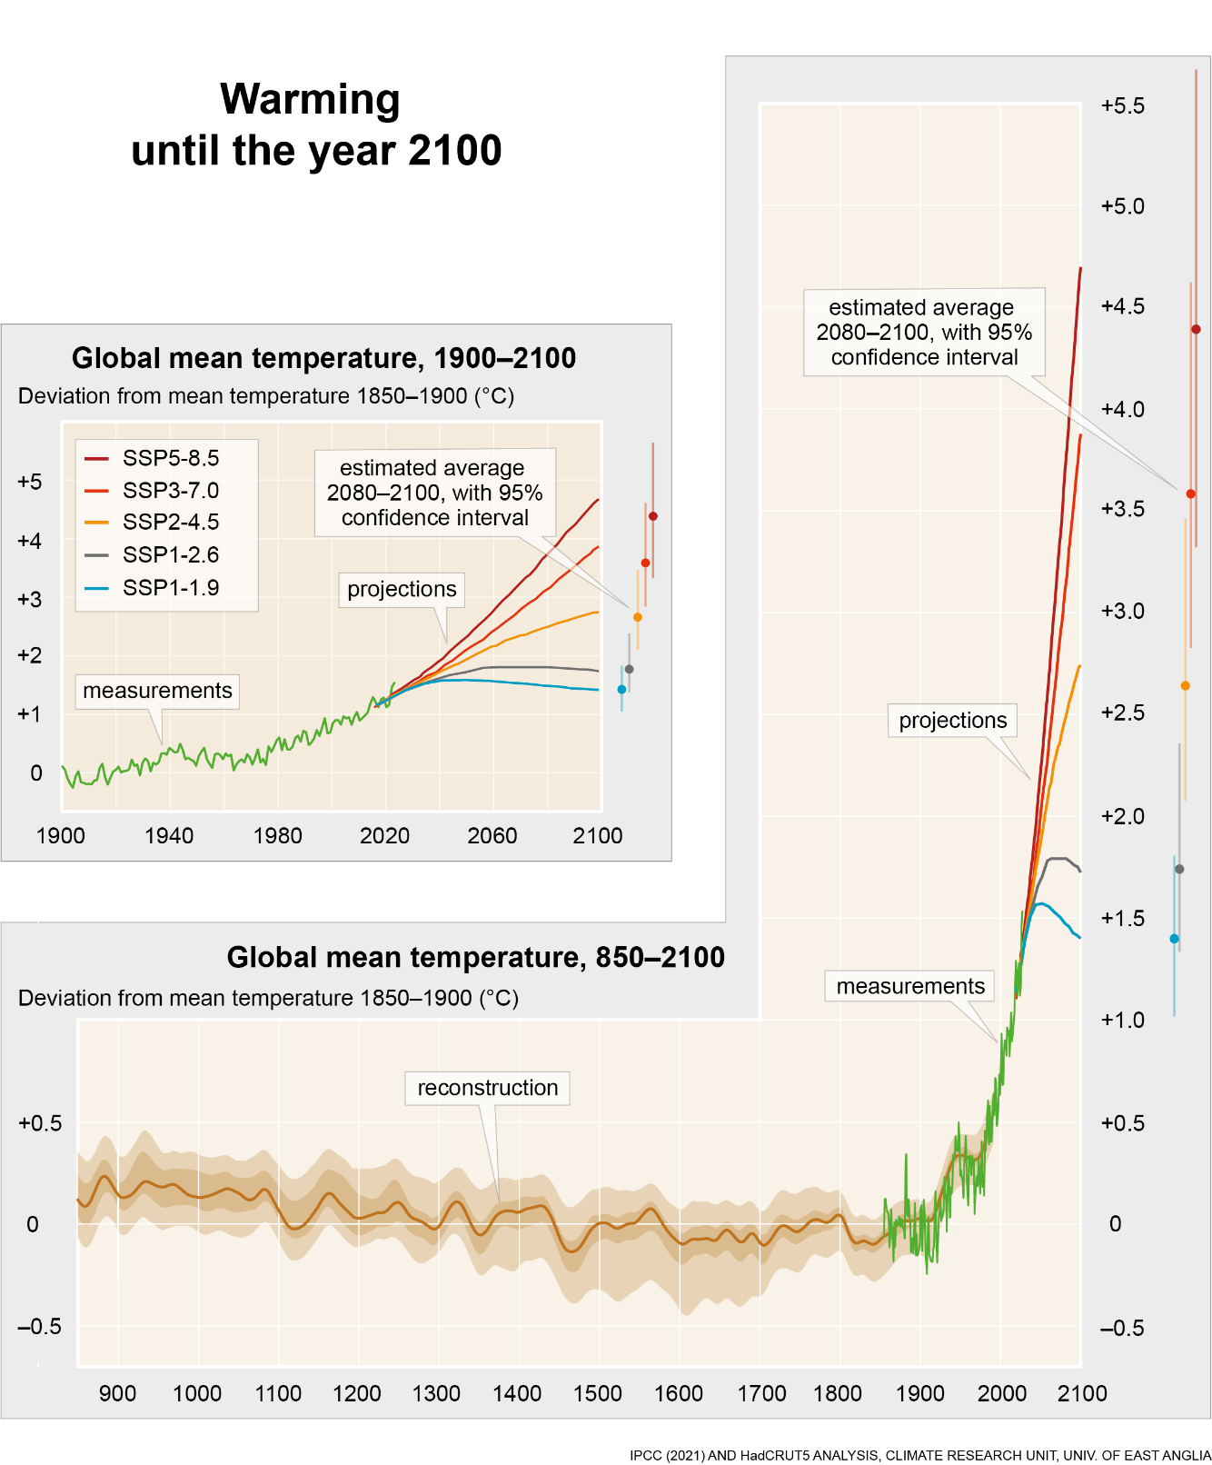
Warming until the year 2100
Warming
up to the year 2100
Notes:
Warming up to the year 2100
By the end of this century, the global mean temperature could be several degrees higher than it was around 1900 (see top left graph). The amount of warming depends on how greenhouse gas emissions change in the future. The graph shows estimates based on five different scenarios.
Even in scenarios with drastic future emissions reductions, we should still expect significant changes in the climate compared to past conditions. This is shown in the graph on the right, which combines future warming projections with measurements and reconstructions of temperature variations since the Viking Age. Notably, temperatures remain elevated even in the most optimistic scenarios, despite net emissions dropping to zero within a few decades.

Slide 16
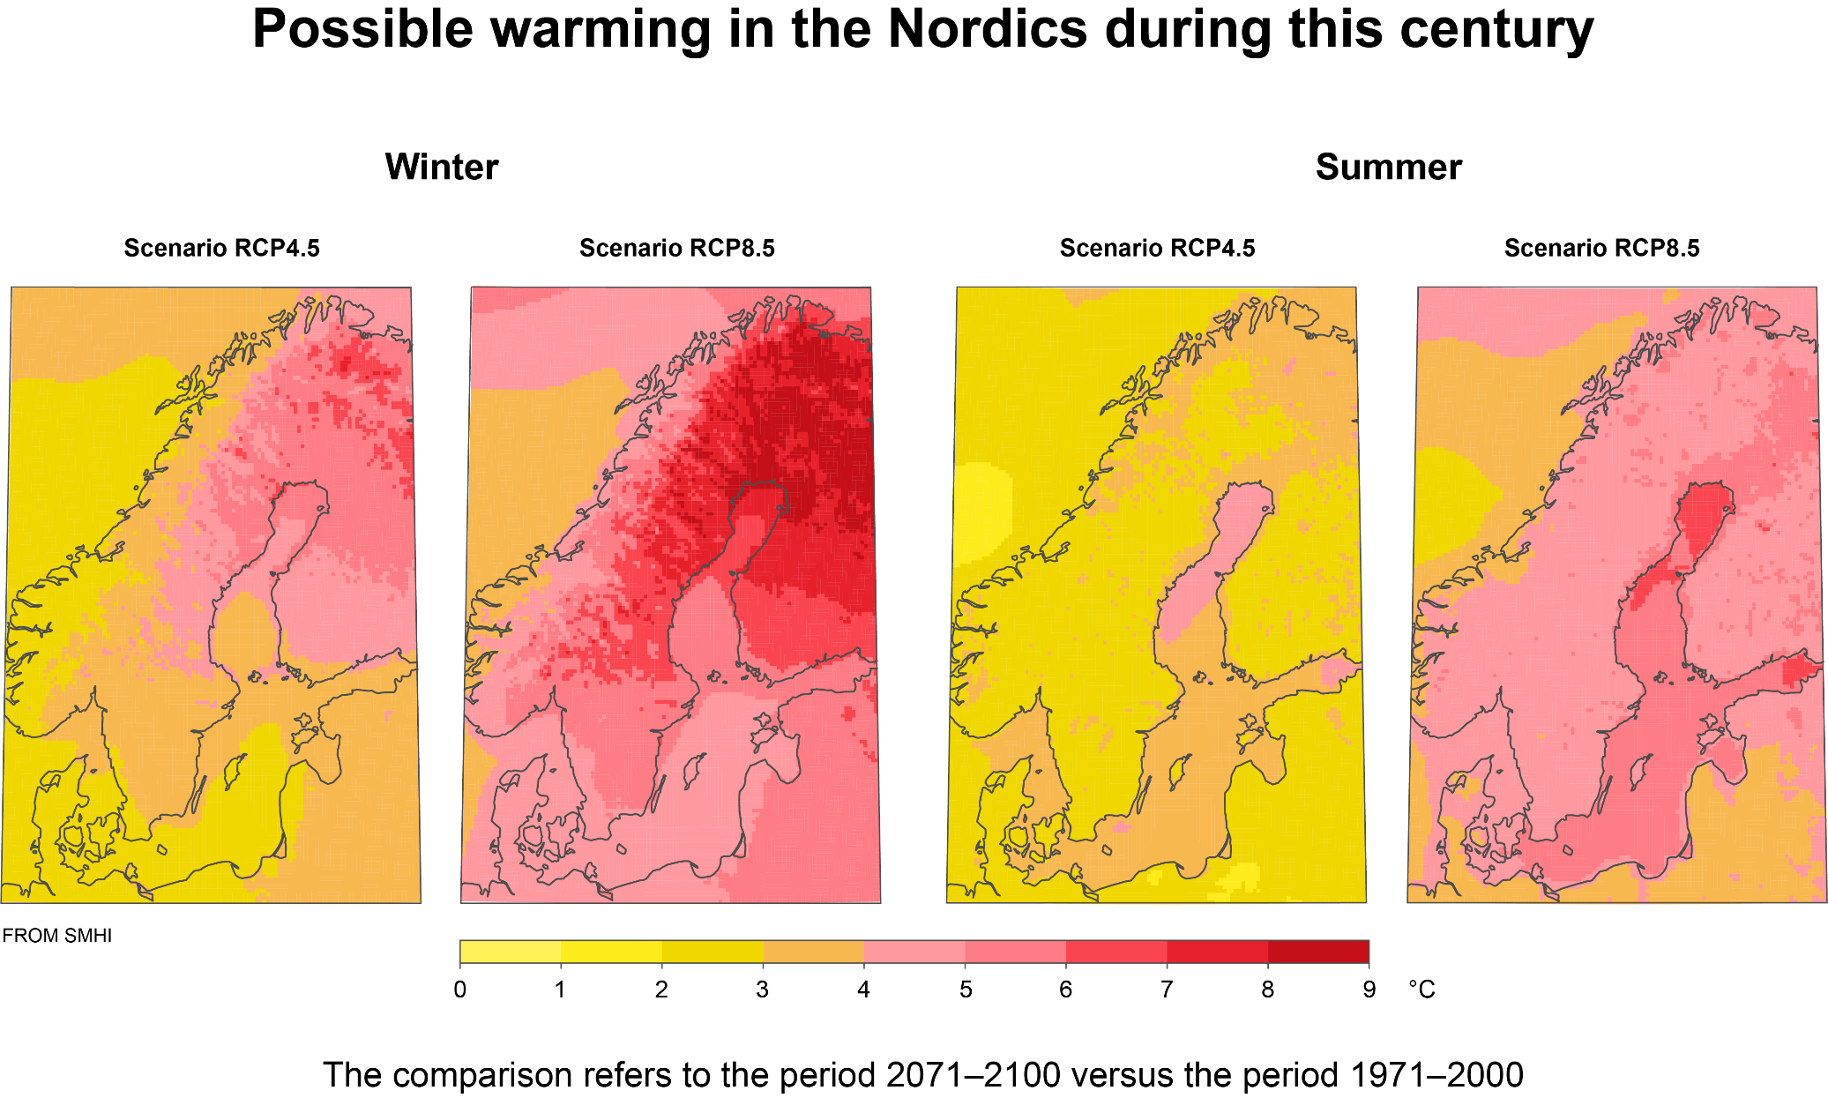
Possible warming in northern Europe during this century
The comparison is for the period 2071–2100 versus the period 1971–2000.
Notes:
Possible warming in northern Europe within this century
In winter, we can expect intense warming in northern Europe partly due to the loss of snow and ice as temperatures rise. As the Earth’s surface darkens, it traps more sunlight, leading to further warming.
In summer, the greatest warming in Europe is instead expected in the Mediterranean region, where the climate can become almost desert-like at that time of year.
These maps are based on two different scenarios for greenhouse gas emissions and concentrations. In one of them, RCP 4.5, emissions are strongly limited in the latter part of our century. In the other map, RCP 8.5, they continue to increase throughout the century. The warming is much greater in the latter case, but the geographical pattern of change is similar in both cases.

Slide 17
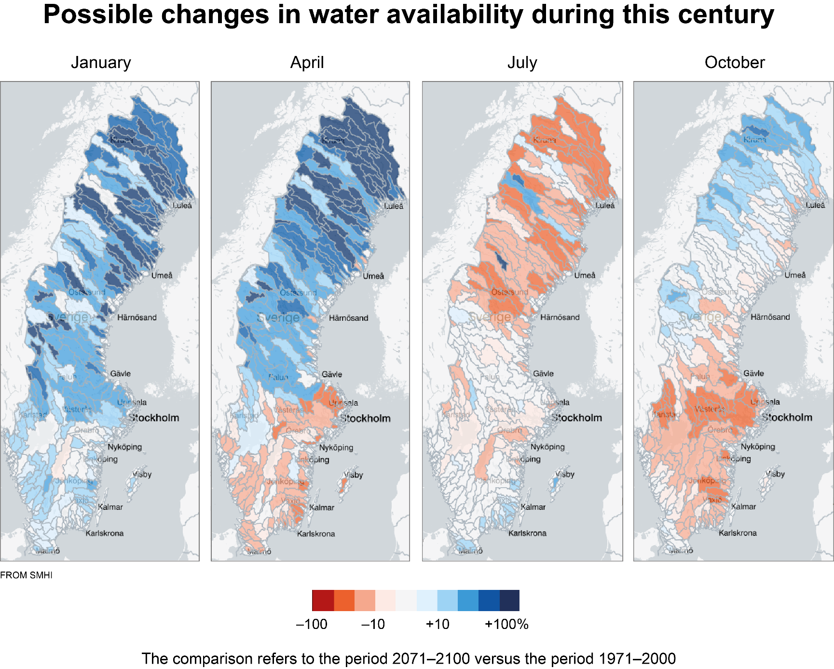
Possible changes in water availability within this century
Notes:
Possible changes in water availability within this century
Precipitation in Sweden is expected to increase, especially during winter but likely in other seasons too. However, rising temperatures may lead to more frequent droughts during the summer due to increased evaporation. This could also result in reduced fresh water availability across much of the country in summer. In southern Sweden, there is a risk of lower water availability also in spring and autumn.
These maps show projected changes in river runoff from the end of the 20th century to the end of the 21st century. They are based on the RCP 4.5 scenario, in which greenhouse gas emissions are significantly reduced in the latter part of the century.

Slide 18
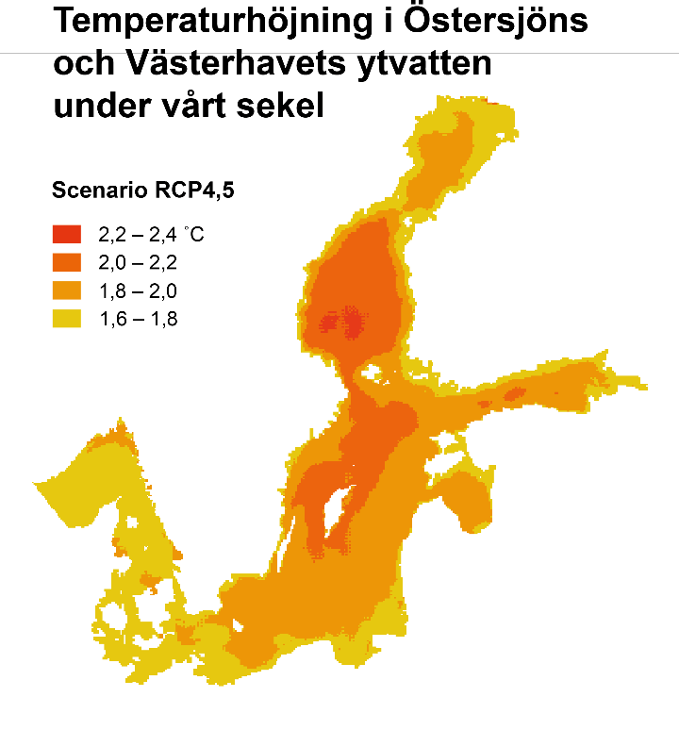
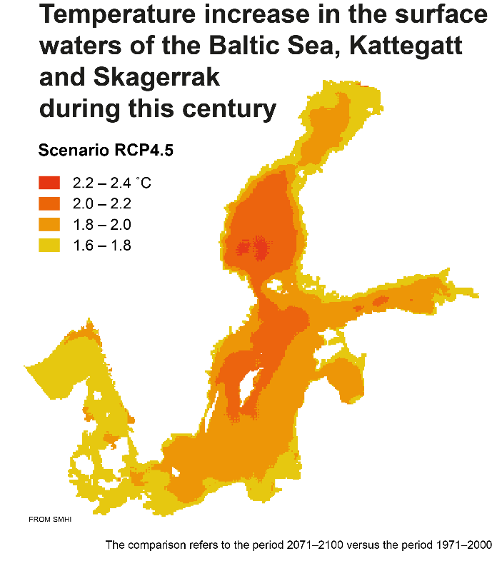
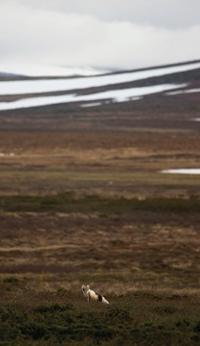
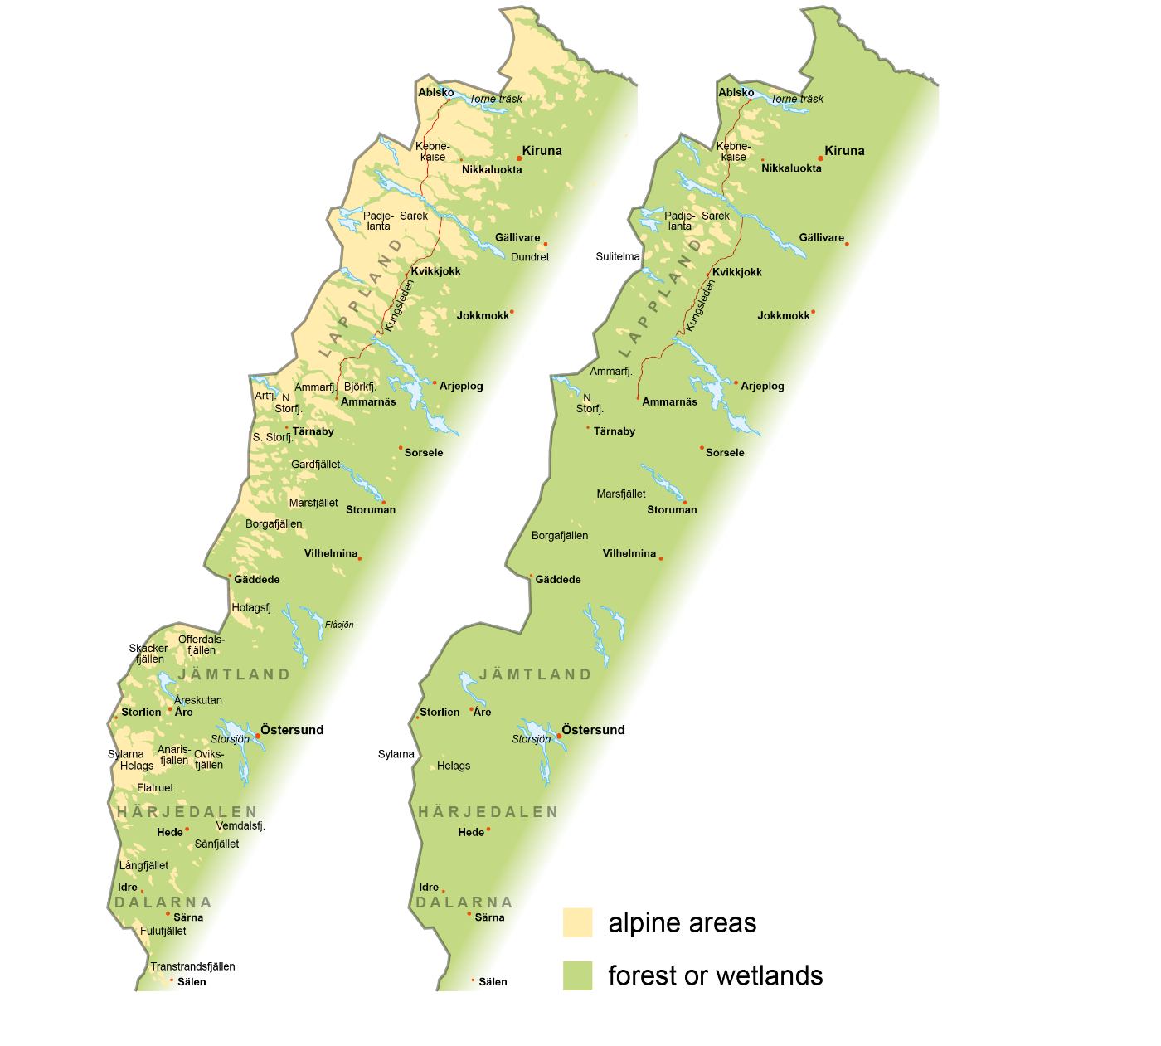
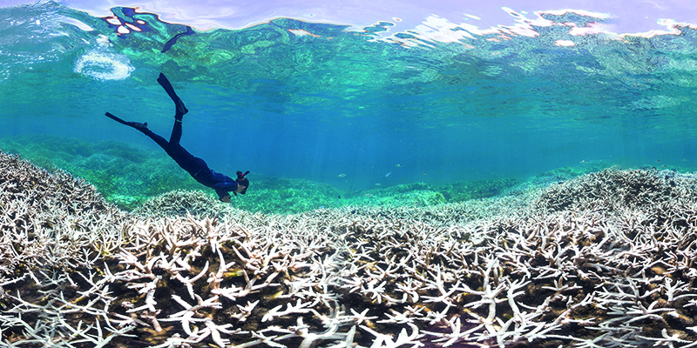
Threatened ecosystems
The Swedish alpine areas today ...
… and after 3-4
degrees warming
^{MIKAEL GUSTAFSSON, N IBL}
The comparison refers to the period 2071–2100 versus the period 1971–2000
^{FROM SMHI}
^{XL CATLIN SEAVIEW SURVEY}
Notes:
Threatened ecosystems
Many plant and animal species may struggle to adapt to or move in pace with future climate change, putting them at risk of at least local extinction. Ecosystems will gradually evolve, with some potentially changing beyond recognition.
One such threatened ecosystem is Scandinavia’s alpine (treeless mountain) areas, which could shrink dramatically as forests encroach on higher altitudes (see the maps on the left and the photo of the Arctic fox, one of the species at risk of being forced away).
Warming in the sea areas surrounding Sweden can also be expected to significantly affect plant and animal life, such as by reducing oxygen availability at the seabed.
In tropical seas, coral reefs have already been extensively damaged (see bottom right photo), not only by warming but by the acidification of seawater due to CO₂ emissions.

Slide 19
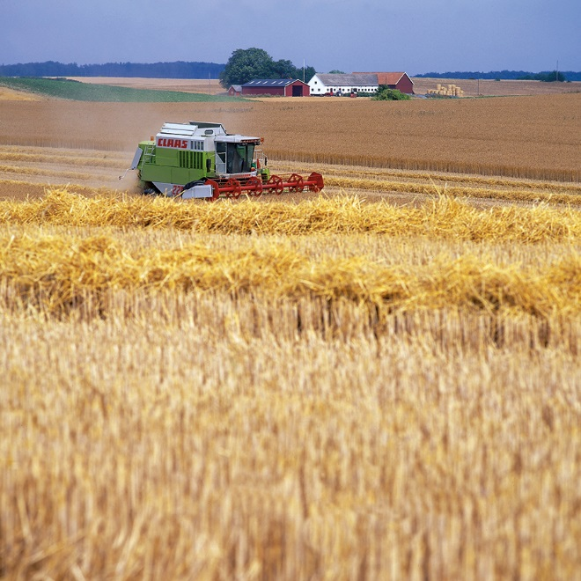
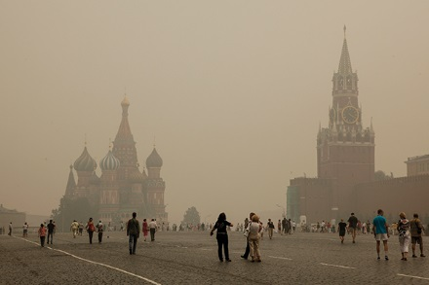
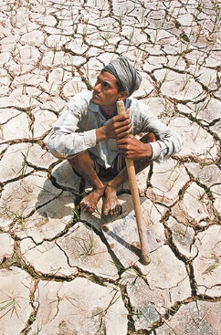
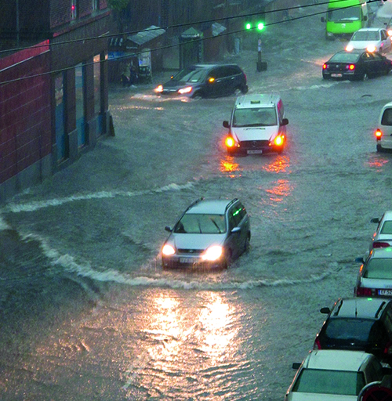
Climate change and society
ATHANASIOS GIOUMPASIS, GETTY IMAGES
LARS JARNEMO/N/IBL (SKÖRD), TT NYHETSBYRÅN (LANTARBETARE)
^{LISA RISAGER, CREATIVE COMMONS}
Notes:
Climate change and society
In Sweden and other countries with a relatively cool climate, a changing climate can increase agricultural and forestry productivity, at least initially. But warmer countries risk reduced yields (see the photos on the left from Scania in southern Sweden and India, respectively). A continued sharp rise in temperatures could eventually threaten global food security.
In a future climate, some extreme weather events might become much more frequent. This could cause an increase in economic damage and/or negative impacts on health. One example is extreme heatwaves, which have already started to occur more frequently. Several heatwaves in recent years have caused tens of thousands of deaths in Europe alone (the top-right photo shows Moscow, when it was engulfed in smoke from surrounding forest fires during the 2010 heatwave).
As another example, torrential rainfall is expected to become more frequent, intense or both in many places, increasing the risk of flooding (the picture on the bottom right was taken during a torrential rainfall in Copenhagen in 2011). In the long run, however, sea level rise will prove to be the most expensive consequence of climate change for our communities.

Slide 20
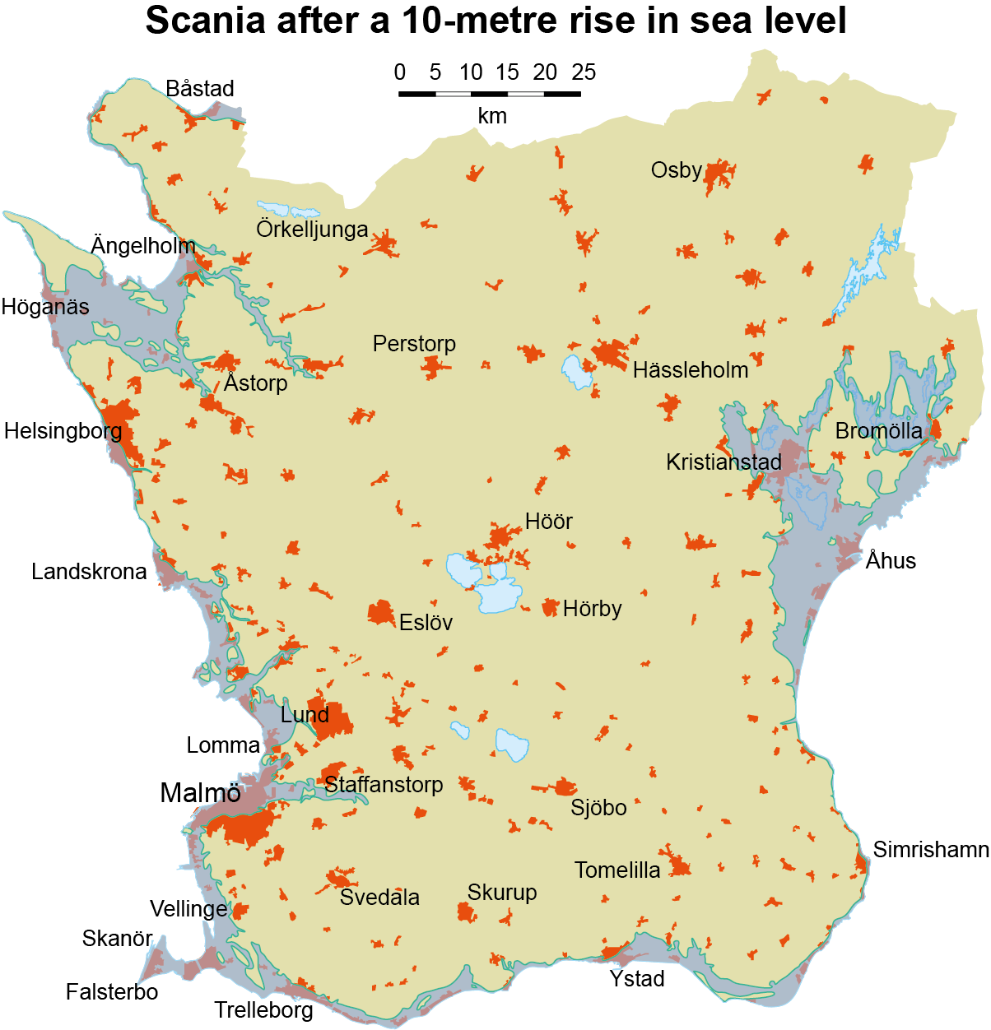
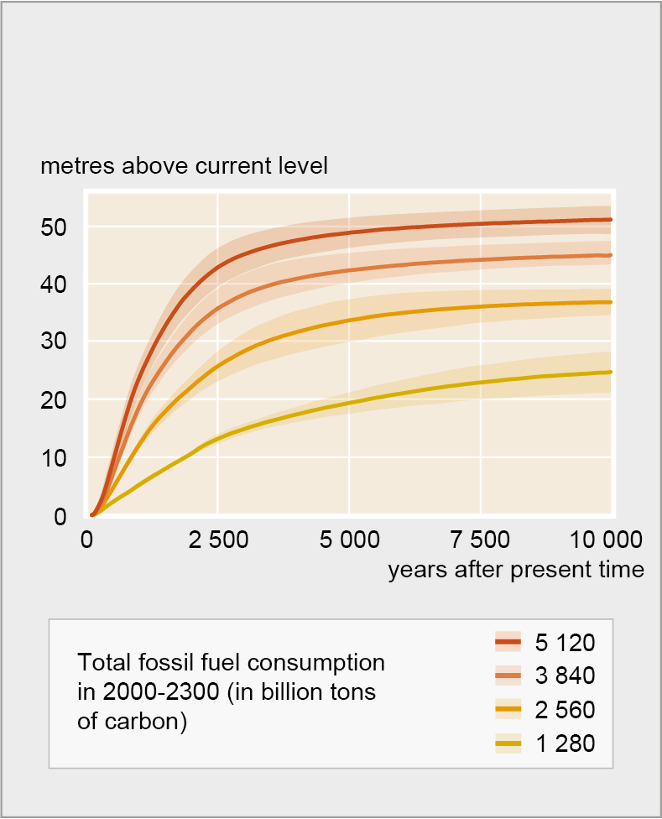
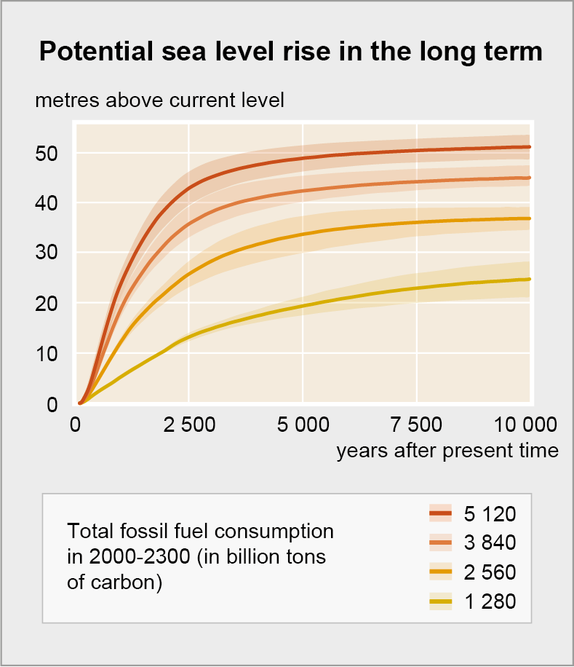
How much will the sea level rise?
Potential sea level rise in the long term
^{FRÓM CLARK ET AL. (2016)}
Notes:
How much will the sea level rise?
The global warming that humans are causing will have long-lasting consequences. The sea could gradually rise several metres over the coming centuries and millennia, even if we were to completely stop greenhouse gas emissions within a few decades. In the long term, it is mainly the ice sheets of Greenland and the Antarctic that will contribute to sea level rise, as they are expected to gradually shrink in the warmer climate.
The extent of sea level rise will depend on the total amount of carbon dioxide and other greenhouse gases we emit. If we use up all the fossil fuel reserves known today, sea levels could rise by a good ten metres in a few thousand years. In that case, significant areas will be under water, such as Scania’s built-up regions and best arable land (map on the right).
Besides the known fuel reserves, there are apparently much greater fossil fuel resources that have not yet been discovered or identified in detail. If we were to use them up as well, the sea could rise by as much as fifty metres over time. Sea level rise – however extensive – is something that will affect the world well into the future. But sea level rise is already affecting us in many parts of the world, such as Scania. With its non-existent land uplift and erosion-prone coastline, it is facing the growing challenge of flooding and washed-out beaches.

Slide 21
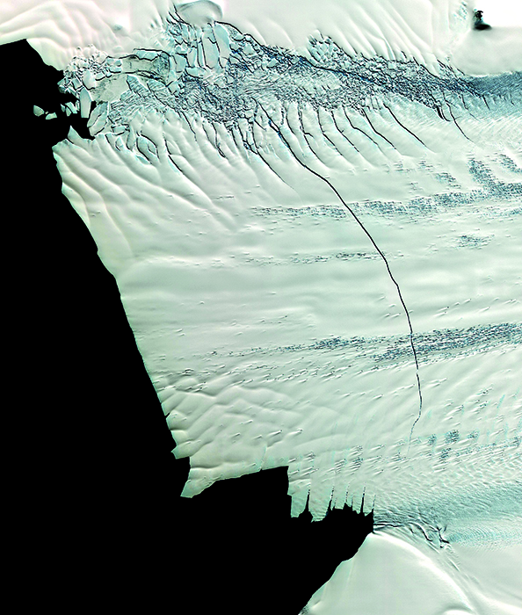
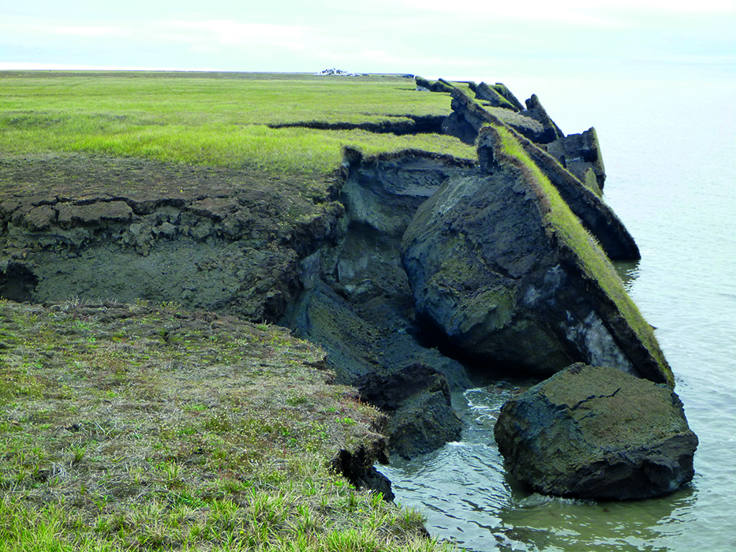
Risk of threshold effects
NASA GODDARD SPACE FLIGHT CENTER
ALASKA SCIENCE CENTER, US GEOLOGICAL SURVEY
Notes:
Risk of threshold effects
The more human impact on climate continues to increase, the greater the risk of threshold effects. These are unexpected, rather sudden changes that might be irreversible even if our climate impact later decreases again.
For example, it is conceivable that unstable parts of the Antarctic ice sheet could break off and slide into the sea, causing sea levels to rise by several metres within a century or two. The satellite image on the left shows a 30-kilometre-long crack in a glacier tongue reaching into the sea from Antarctica. If glacier tongues like these break up and dissipate, ice from inland can start flowing more quickly into the sea. Another example of a threshold that could be breached would be a collapse of the Atlantic Meridional Overturning Circulation (AMOC), which includes the Gulf Stream. This could have significant repercussions for climate conditions on both sides of the Atlantic.
There are also concerns that major amounts of carbon dioxide and methane could be released from frozen soil layers and ocean sediments in the Arctic if warming causes them to thaw. If this happens, the greenhouse effect would be further amplified, resulting in even greater warming. In the photo on the right, an Alaskan barrier beach is collapsing as the previously permanently frozen soil layers are exposed to rising temperatures and increased wave erosion.

Slide 22
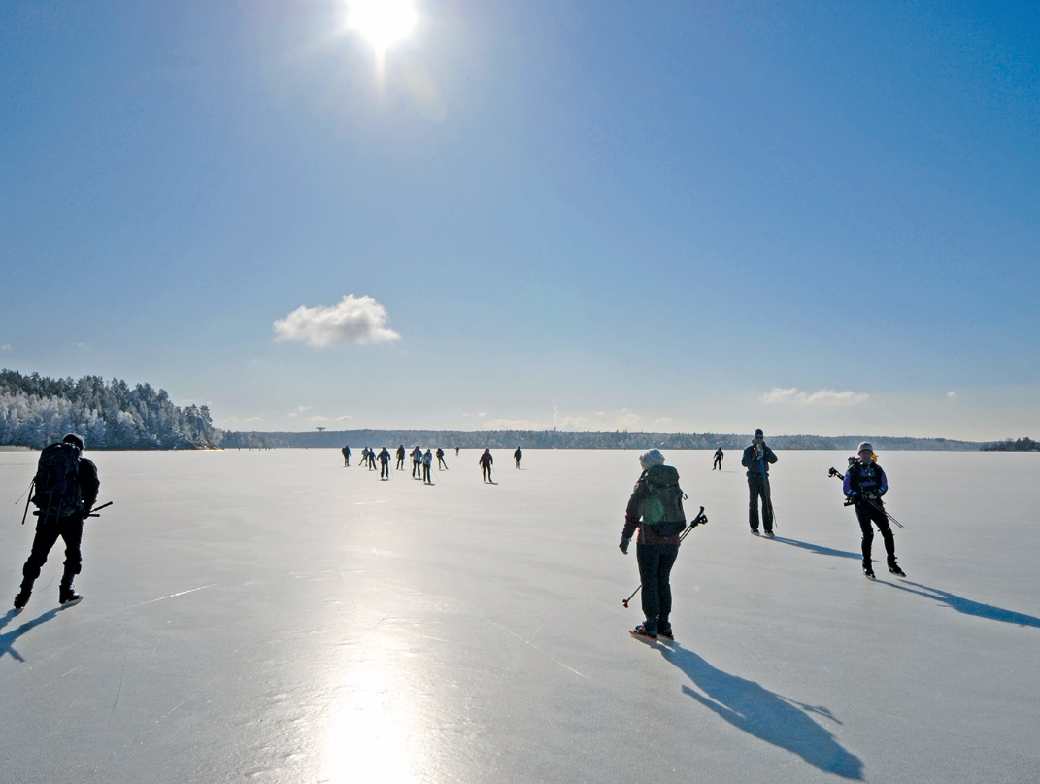
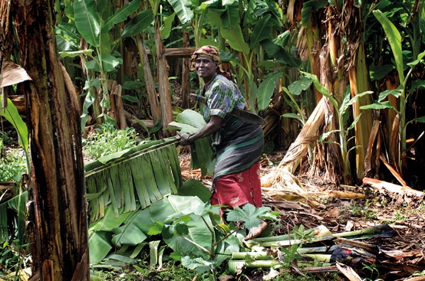
It’s not too late to limit climate disruption
^{JOHAN BERNES (STORA VÄRTAN)}
^{HELENA LANDSTEDT, TT (UGANDA)}
^{VESA MOILANEN, TT (VENICE)}
Notes:
It’s not too late to limit climate disruption
Despite these scenarios, it is not yet too late to limit our impact on the climate. We still have the chance to pass on to our grandchildren a world where the ice is still present in Swedish archipelagos, where people in warmer countries can cultivate their land without their crops being withered by drought, and where Venice still rises above sea level. To accomplish this, we all must be prepared to do something about it.

Slide 23
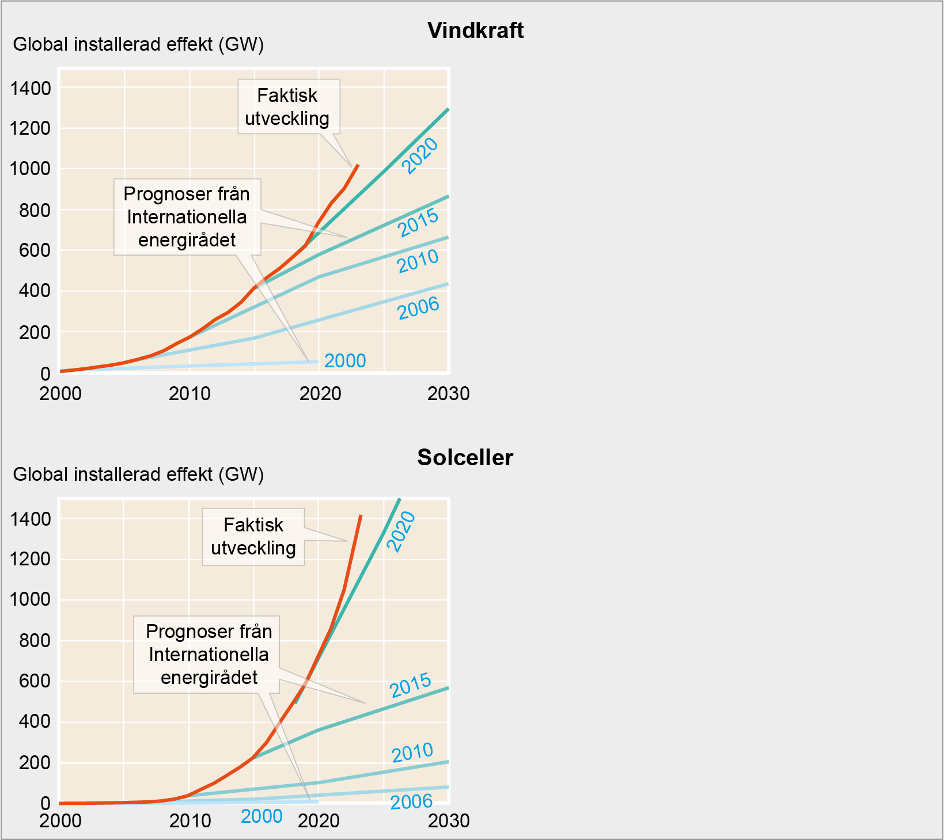
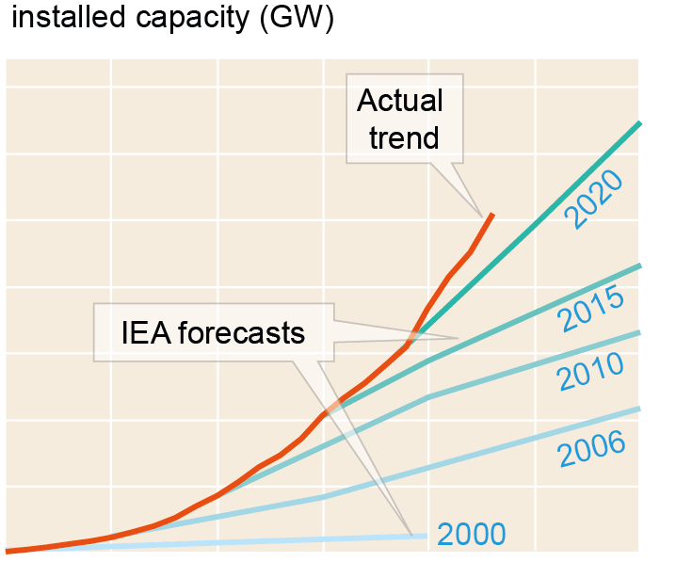
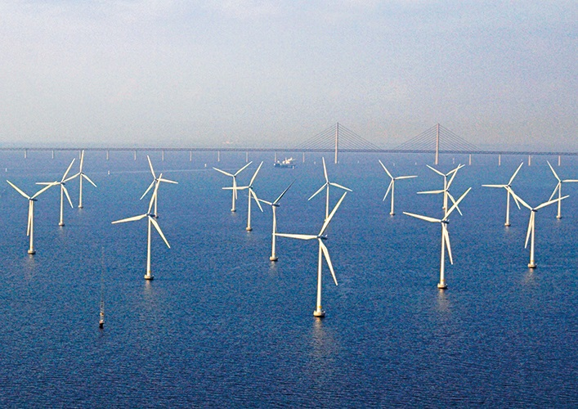
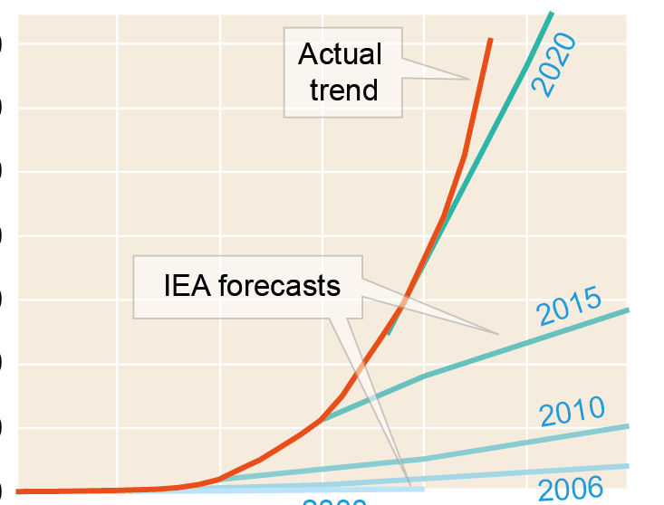
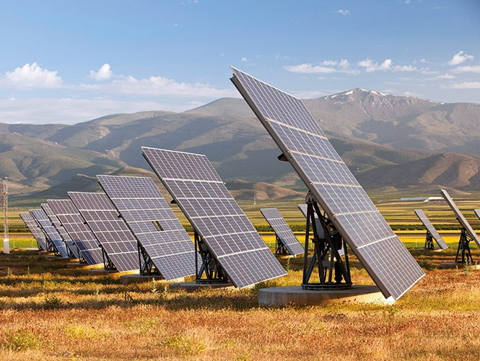
Alternatives to fossil fuels
Global installed capacity (GW)
Wind power 2000–2030
^{HANS BLOMBERG}
Global installed capacity (GW)
Photovoltaics 2000–2030
^{ASHLEY COOPER, IBL}
FROM WORLD ENERGY OUTLOOK, IEA, AND THE INTERNATIONAL RENEWABLE ENERGY AGENCY
Notes:
Alternatives to fossil fuels
In the past, the potential for large-scale substitution of fossil fuels with alternative energy sources was often underestimated. Both wind power and photovoltaics have become increasingly competitive, and are now being installed on a scale that few predicted just a few years ago. The charts show how the International Energy Agency has had to adjust its forecasts for the rate of expansion upwards year on year. Reality has consistently exceeded expectations. The deployment of energy storage is another example where recent developments have tended to outpace initial predictions.
Replacing fossil fuels with alternative fuels must also go hand in hand with improving energy and resource efficiency. Otherwise, the climate transition will be significantly more difficult and more prone to conflicts over issues like mineral extraction, biodiversity and food security.

Slide 24
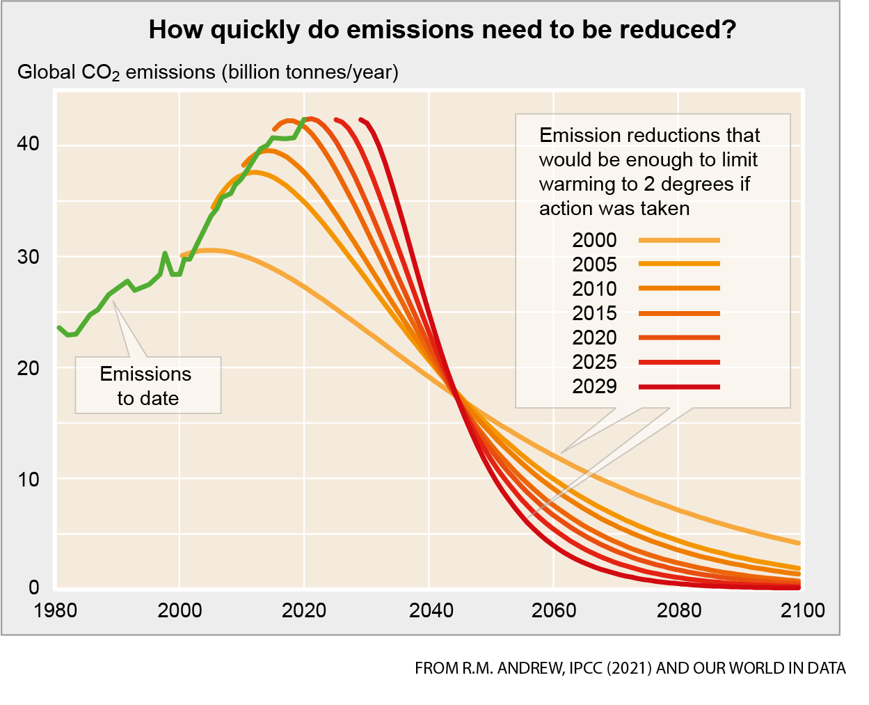
There’s no time to lose
FROM R.M. ANDREW, IPCC (2021) AND OUR WORLD IN DATA
Notes:
There’s no time to lose
The longer we delay reducing CO₂ emissions, the faster we’ll need to reduce them in the coming years to keep global warming at a reasonably manageable level. The graph illustrates how CO₂ emissions must change depending on when we start, in order to limit warming to two degrees. Had we begun reductions around 2000, a more gradual approach would have sufficed compared to the drastic measures we need now. The Paris Agreement aims to limit warming to well below 2°C, preferably below 1.5°C, relative to pre-industrial levels.

Slide 25
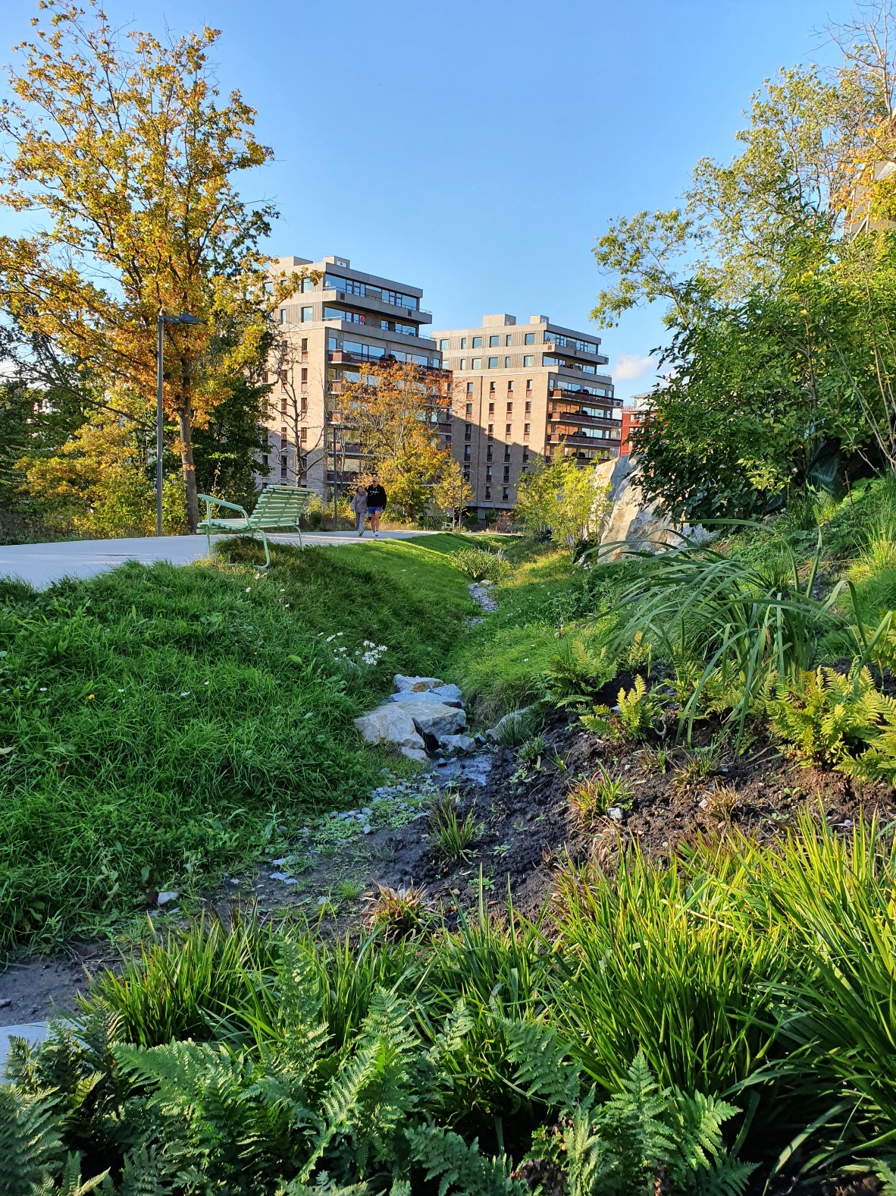
Adaptation to climate change
^{TIMO PERSSON}
Notes:
Adaptation to climate change
Global warming is a reality, and reducing greenhouse gas emissions alone is not enough to address this challenge. Society must also adapt to the effects of climate change we already face and those that are inevitable in the future. Since climate change impacts all aspects of society, adaptation is required across every sector. This ranges from urban planning that mitigates flood risks from heavy rain or rising sea levels, to healthcare initiatives that can manage health risks related to heatwaves.
Harnessing nature’s own resilience is a prime example of effective adaptation. Nature-based solutions, such as parks, tree-lined streets and wetlands, can help us manage many climate risks like floods and heatwaves while offering additional benefits, including recreational spaces and enhanced biodiversity. This image of a swale in Norra Djurgårdsstaden, Stockholm, offers one example. In addition to managing stormwater, the open swale supports biodiversity and adds a recreational feature to the urban landscape.

Slide 26
Reference source
Updated from: Bernes, Claes (2016). En varmare värld, 3rd edition. Stockholm: Swedish Environmental Protection Agency.

